Slide 2
ManhattanLife
welcomes
Jack D. Broughton
RVP, National Sales Director
ManhattanLife
(O) : 678-567-2238
(M): 470-774-4654
jackbroughton@manhattanlife.com
July 2, 2024

Slide 4
OmniFlex Topics
Why a Home Health Care Plan?
Who needs OmniFlex?
Product Overview
Application
FAQ’s
State Availability

Slide 5
OmniFlex – Who needs it?
Why a Home Health Care Plan?

Slide 6
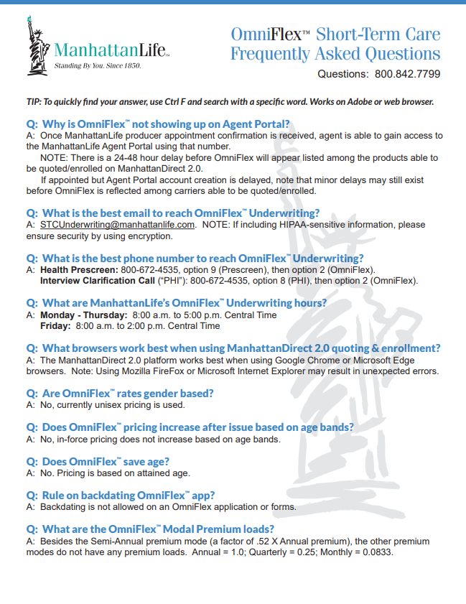
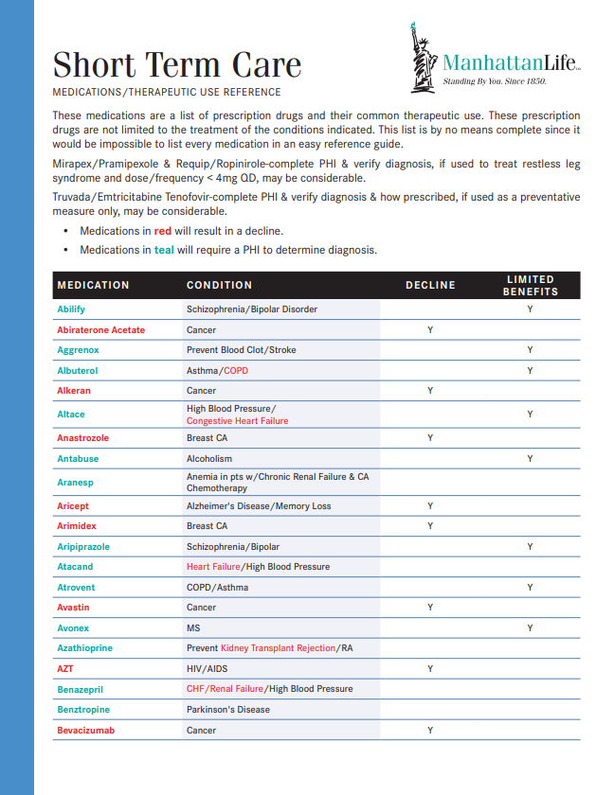
OmniFlex - Important Forms
Why a Home Health Care Plan?
Agent Guide
Brochure
Medications
FAQ’s

Slide 7
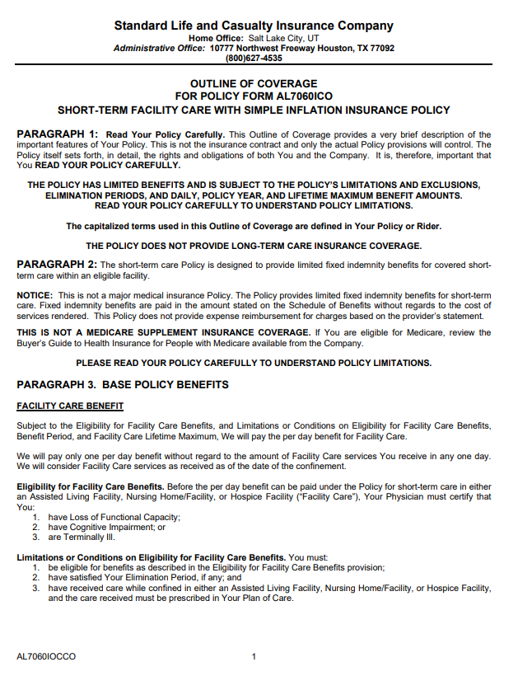
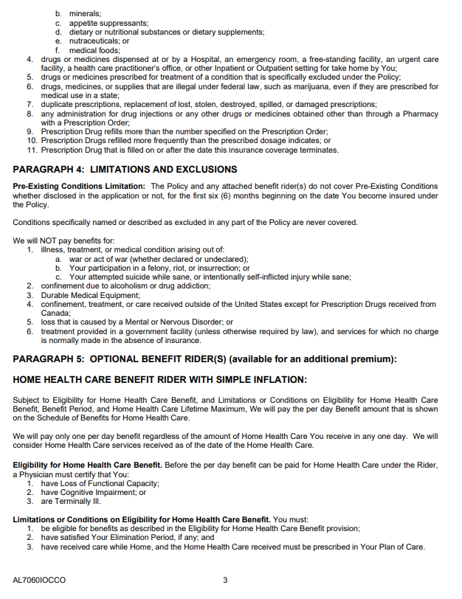
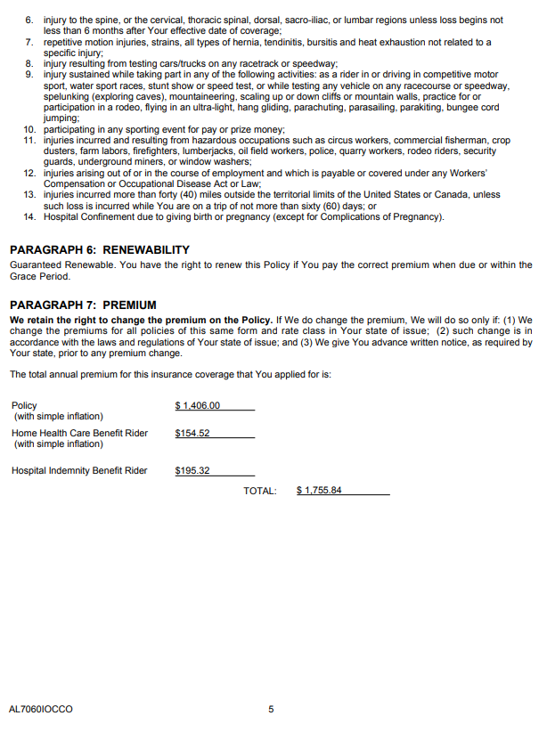
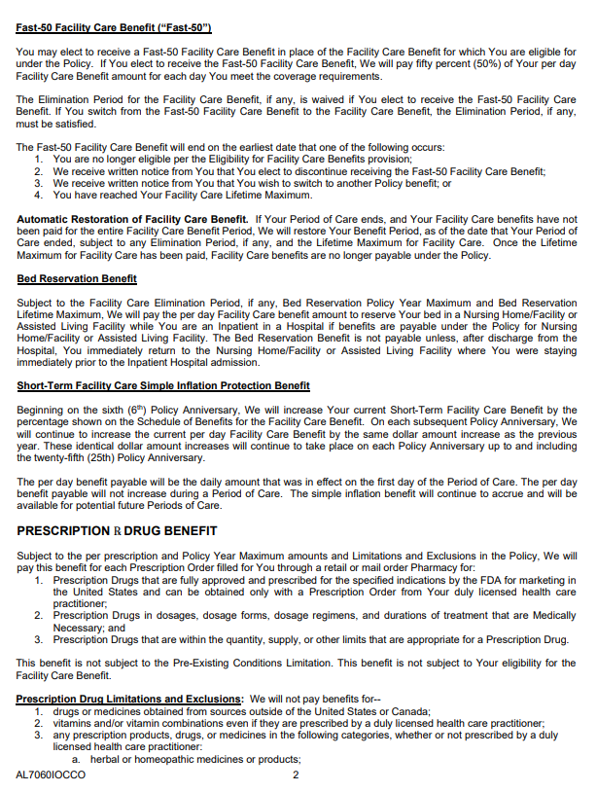
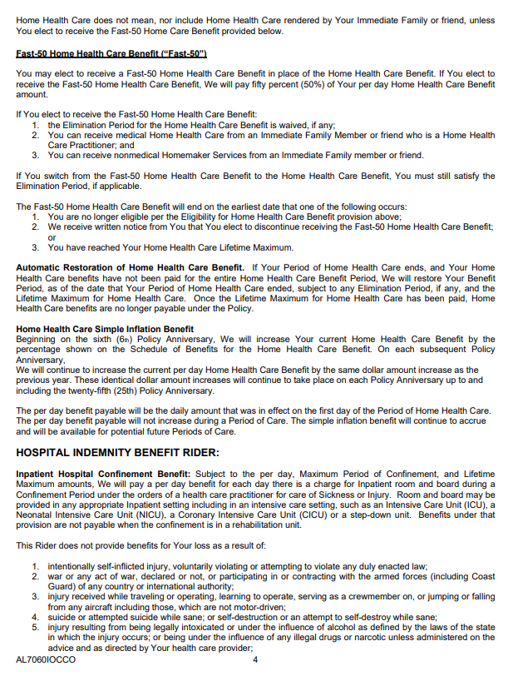
OmniFlex – Outline of Coverage
Why a Home Health Care Plan?

Slide 8
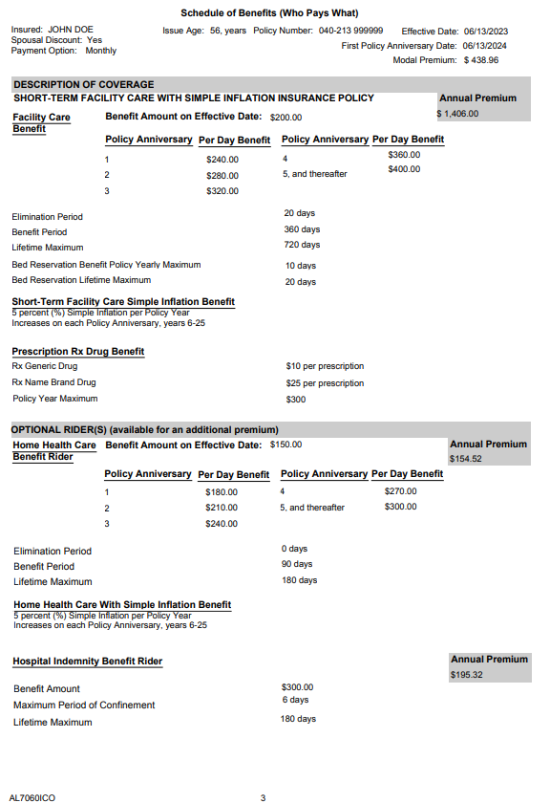
OmniFlex – Outline of Coverage
Why a Home Health Care Plan?
SAMPLE

Slide 9
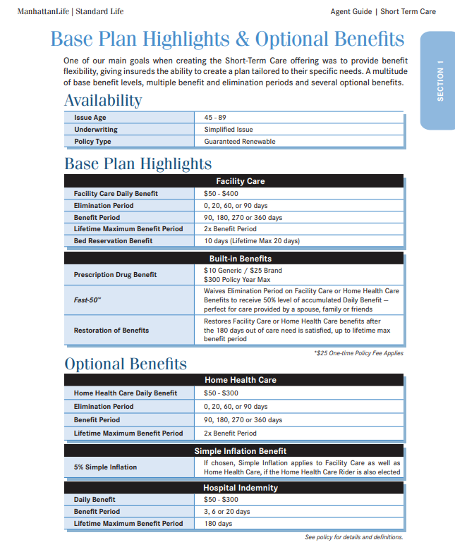
OmniFlex – Product Overview
Why a Home Health Care Plan?

Slide 10
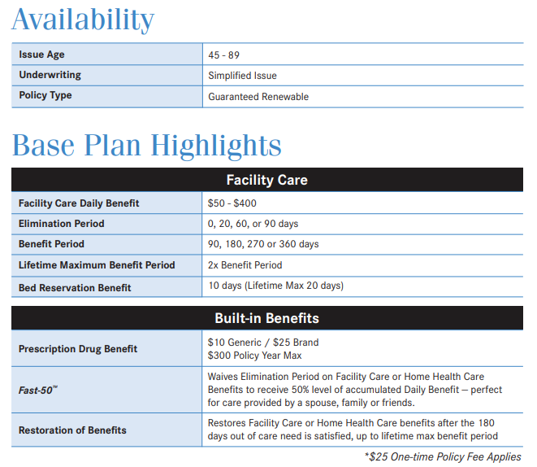
OmniFlex – Product Overview
Why a Home Health Care Plan?

Slide 11
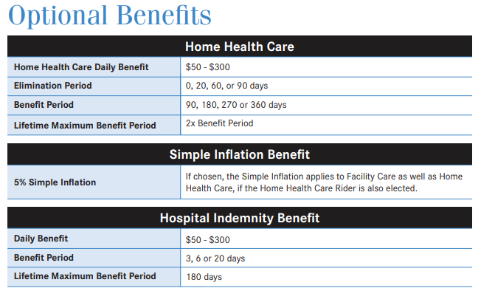
OmniFlex – Product Overview
Why a Home Health Care Plan?

Slide 12
OmniFlex – Product Overview
Why a Home Health Care Plan?
“Triggers”

Slide 13
OmniFlex – Application
Why a Home Health Care Plan?

Slide 14
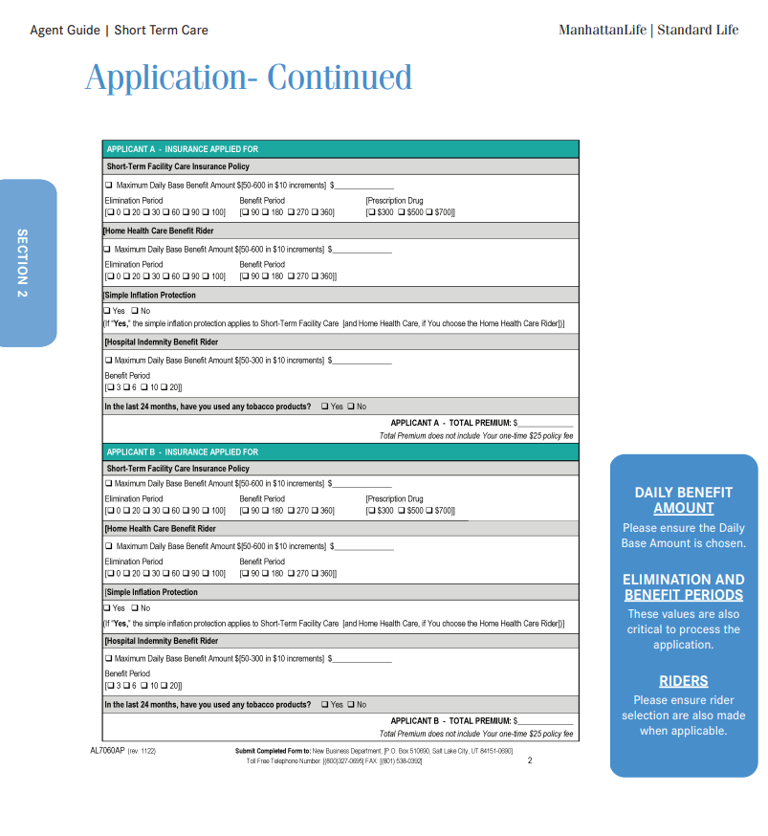
OmniFlex – Application
Why a Home Health Care Plan?

Slide 15
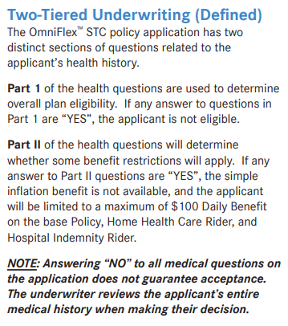
OmniFlex – Application
Why a Home Health Care Plan?

Slide 16
OmniFlex – Application
Why a Home Health Care Plan?

Slide 17
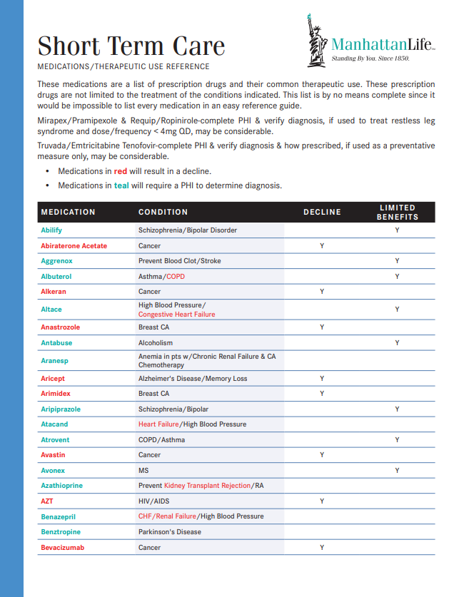
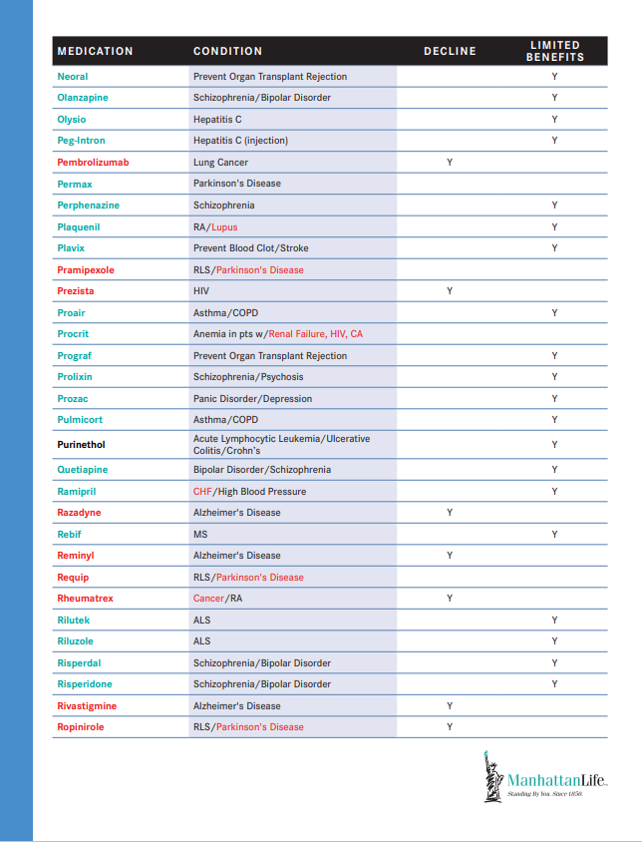
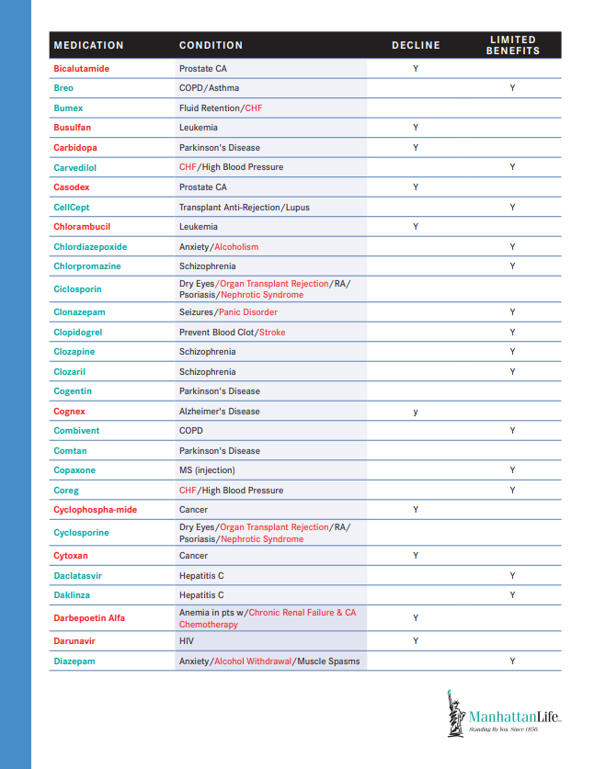
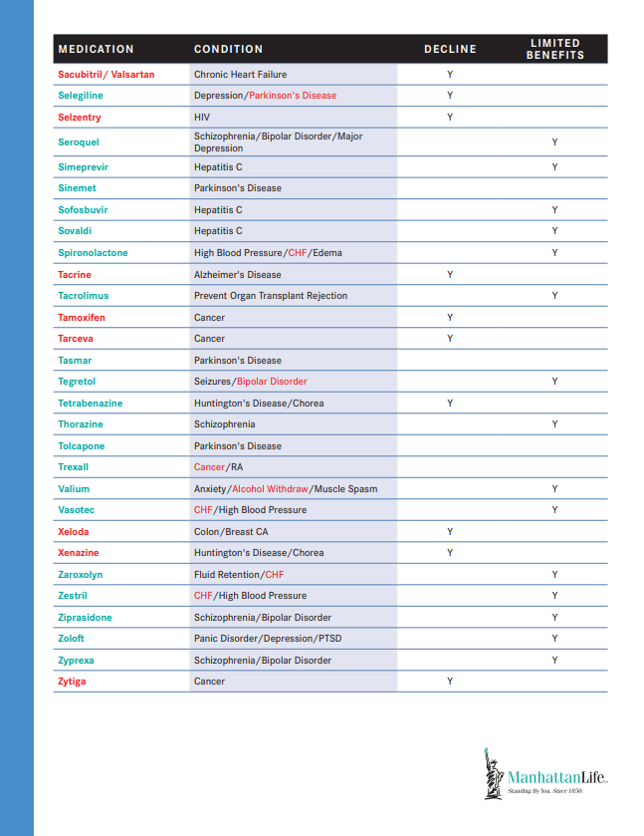
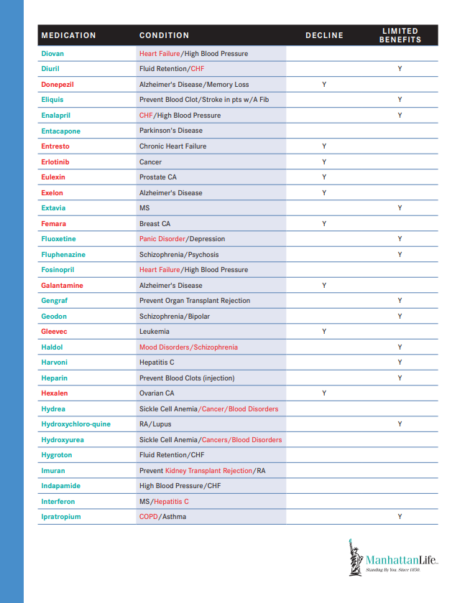
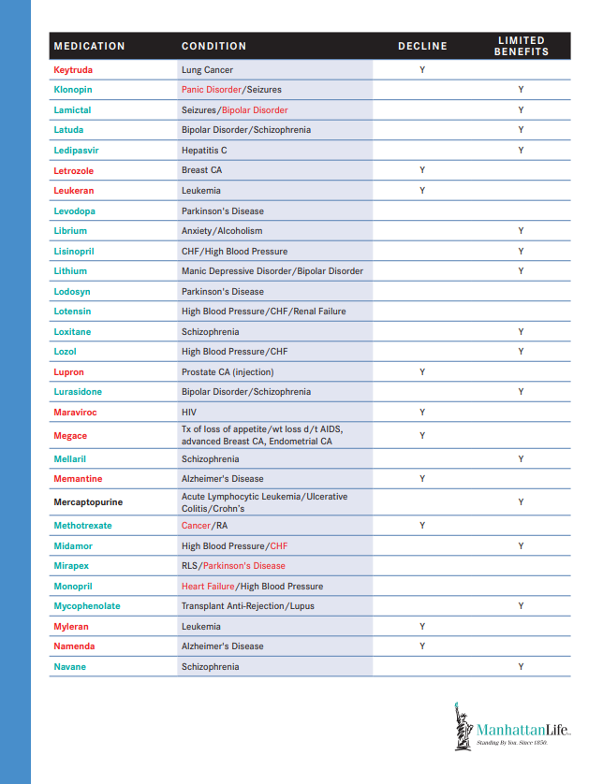
OmniFlex – Restricted Medications
Why a Home Health Care Plan?

Slide 18
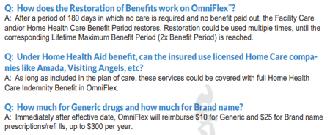
OmniFlex – FAQ’s
Why a Home Health Care Plan?

Slide 19
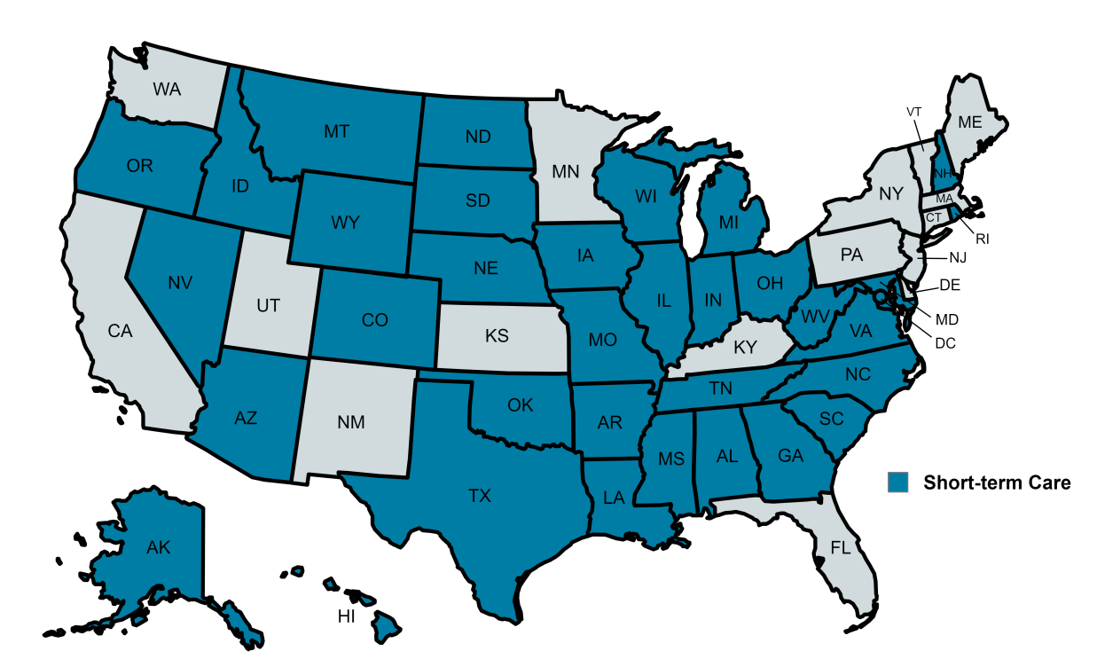
OmniFlex – State Availability
Why a Home Health Care Plan?

Slide 20
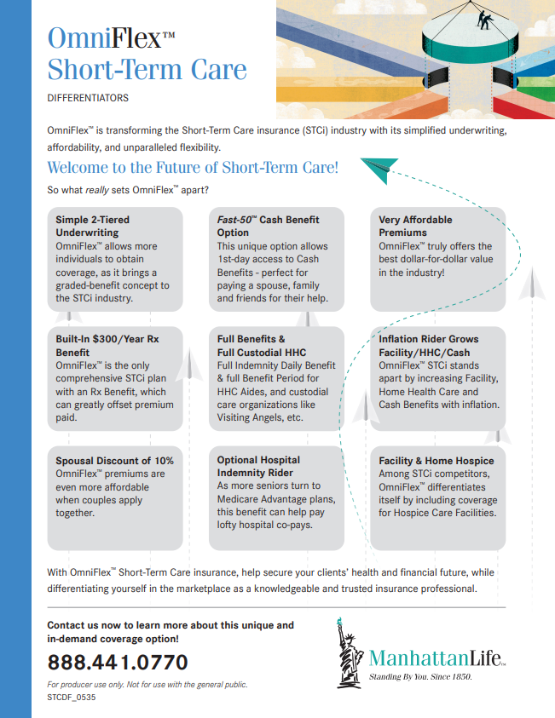
OmniFlex Summary
Why a Home Health Care Plan?

Slide 21
ManhattanLife’s Featured Product
Why a Home Health Care Plan?

Slide 22
Why HHC?
Home health care is an increasingly popular option for consumers needing care. Home Health Care Insurance is an affordable solution allowing the insured to receive the care they need in the comfort of home.

Slide 23
Today’s Product Introduction
Value
Cost
Issued

Slide 24
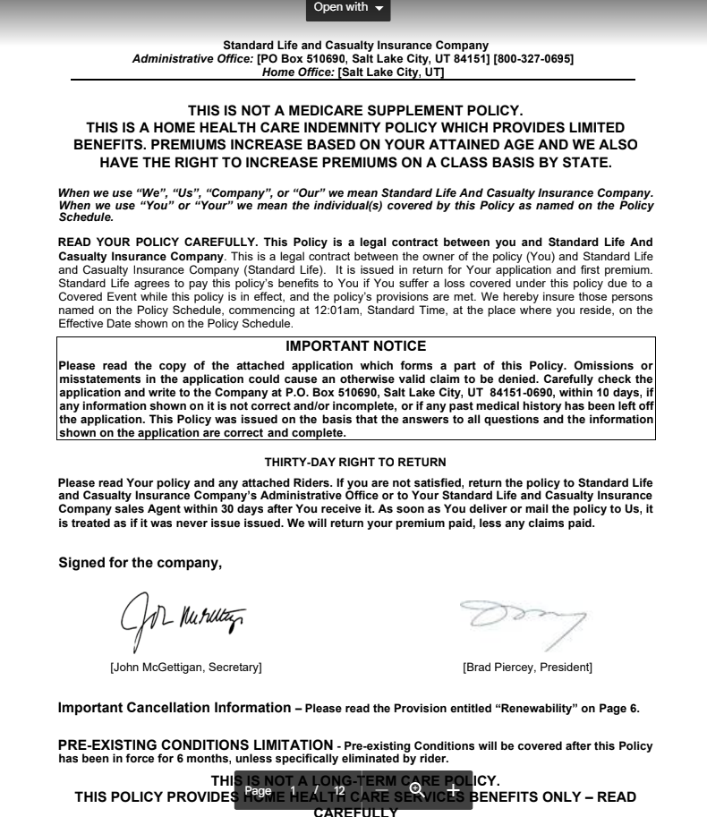
HHC – Select 30 Day “Free Look”
Why a Home Health Care Plan?

Slide 25
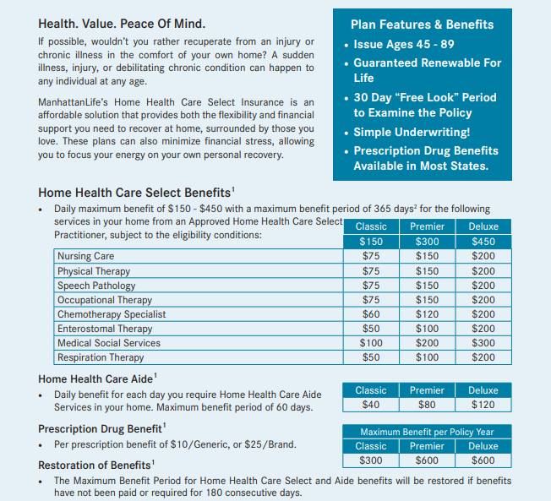
Home Health Care – Highlights
Why a Home Health Care Plan?

Slide 26
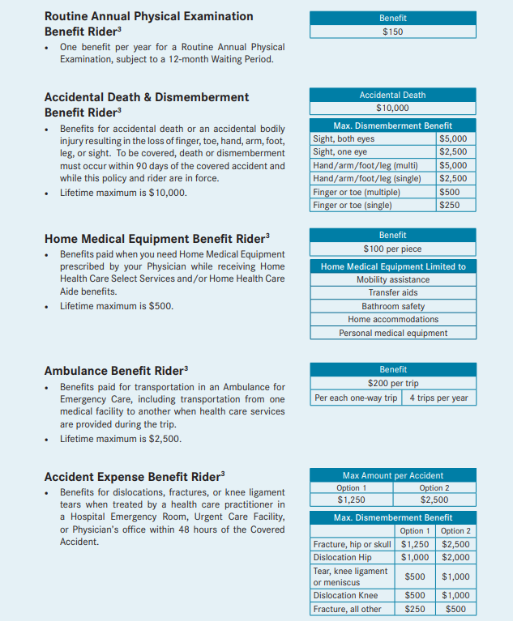
Home Health Care – Riders
Why a Home Health Care Plan?

Slide 27
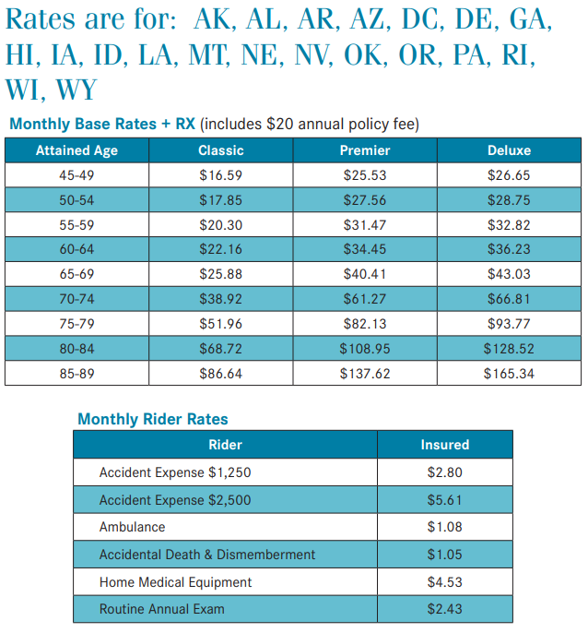
HHC – Select “Monthly Rates”
Male/Female
Smoker/non-smoker
Bank Draft (EXAMPLE)
Age – 65 (EXAMPLE)
Riders
$14.70
$40.41 Base Plan
$14.70 Riders
$55.11 Per Month
$55.11 x 12 = $661.32 Ann. Cost
$600.00 R/X reimbursement
“Issue Age”

Slide 28
Home Health Care - Select “Triggers”
Why a Home Health Care Plan?

Slide 29
Home Health Care – Select “Features”
Why a Home Health Care Plan?

Slide 30
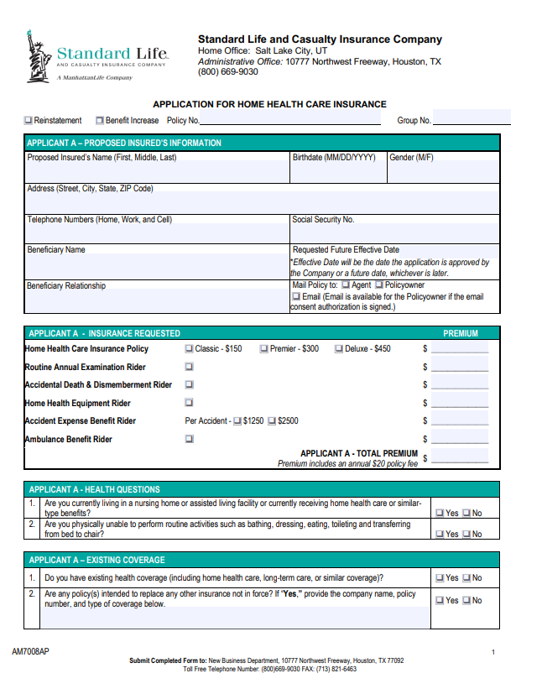
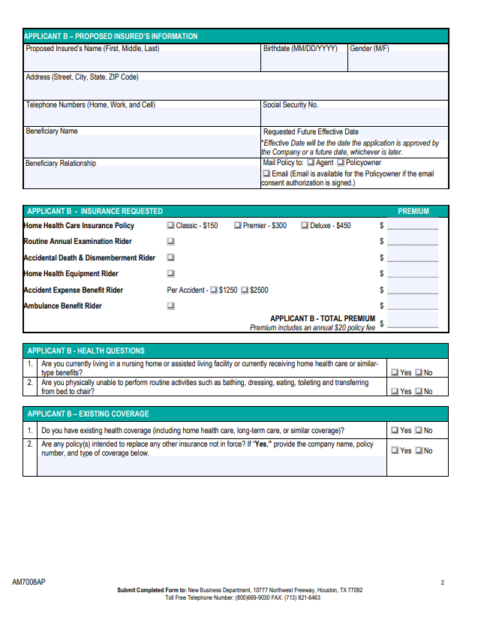
Home Health Care Select – Application
Why a Home Health Care Plan?
Front
Back

Slide 31
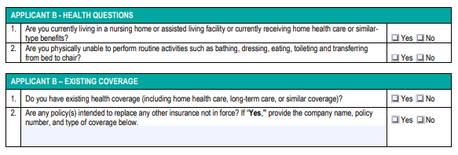
Home Health Care Select – Application
Why a Home Health Care Plan?

Slide 32
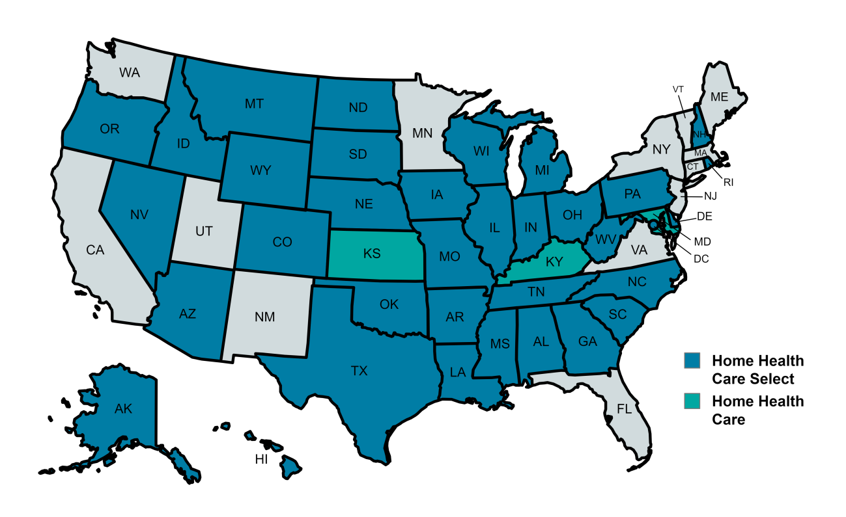
Home Health Care - Select
Why a Home Health Care Plan?

Slide 33
Thank You
Jack D. Broughton
Regional Vice President
(O) : 678-567-2238
(M): 470-774-4654
jackbroughton@manhattanlife.com
or
800-369-3600
ACES@Manhattanlife.com

