Slide 1
Self-Funded program
Big-business benefits in a small-business program.
02. 17.2023

Slide 2
Challenges for small business clients

Slide 3
Rising health care costs
Health care costs continue to rise.
Average premium is going up, and inflation isn’t keeping up.
  Average premium for family coverage increased 54% in the past 10 years, climbing 22% in the last five years.¹
  Dramatically outpacing both inflation and wage growth in the U.S. In 2019 alone, average annual premiums for family coverage increased 5% over 2018 rates, while wages increased just 3.4% and inflation rose by 2%.²
¹ https://www.kff.org/report-section/ehbs-2019-summary-of-findings/
² https://www.cnbc.com/2019/09/26/health-insurance-premiums-increased-more-than-wages-this-year.html
Notes:
1. https://www.kff.org/report-section/ehbs-2019-summary-of-findings/
2. https://www.cnbc.com/2019/09/26/health-insurance-premiums-increased-more-than-wages-this-year.html

Slide 4
COVID-19 crisis
Both the biggest public health crisis of our lifetime and the biggest threat to small to mid-sized businesses since the Great Depression.
Now more than ever, your clients need to offer their employees quality health benefits that give employers the ability to control costs as much as possible.
Notes:
https://www.washingtonpost.com/business/2020/05/12/small-business-used-define-americas-economy-pandemic-could-end-that-forever/

Slide 5
Traditional plans don’t always fit
Traditional fully insured plans take on full risk, but your clients also take premium with no transparency, so they don't know how the money is spent.
This makes it hard to ensure they are doing everything they can to contain costs.

Slide 6
The self-funding solution

Slide 7
Self-funding allows small businesses to control health care costs while offering quality benefits to employees.

Slide 8
Why self-funding?
Lower costs.
Plans are underwritten.
Predictable monthly payments.
Quality benefits.
Stop-loss protection.
More employer control.
Potential for money back.
Notes:
Costs less: Self-funding often costs less than fully insured plans. Employers only pay for the health care services the group uses.
Plans are underwritten: Which can result in lower monthly costs for some groups.
Predictable monthly payments: Employers have predictable fixed monthly payments.
Quality benefits: Robust major medical plans with all first-dollar preventive care required by ACA.
Stop-loss protection: Employers are protected with stop-loss insurance.
More Employer Control: Employers have more control over their health care costs.
Potential for money back: Employer may receive money back if they don’t use all the funds in their claims account.

Slide 9
Who should consider self-funding?
Employers who want to gain control of their health care costs.
Employers looking to save on health care costs and still provide quality benefits to their employees.

Slide 10
Self-Funded Program

Slide 11
We specialize in…
Providing innovative employee benefits solutions that were once only available to large employers.
Self-funded program that
helps employers save on
health care costs.
Tools and resources
that make reporting and managing health care
plans easy.
Options for groups with
2-500 employees.

Slide 12
How self-funding works

Slide 13
Key advantages
Keeps employer costs predictable.
Unique program features.
Access to many network options or reference-based pricing – find the fit for your client.
Clients receive money back in years when claims are lower then expected.

Slide 14



Keeps employer costs predictable by splitting the monthly payment three ways
Notes:
Plan Administration
Stop-Loss Premium
Claims Account

Slide 15
Plan administration
Our third-party administrators handle the day-to-day functions of the program, including:
Managing claims payments.
Administering reports to help manage costs.
Providing outstanding customer service.

Slide 16
Stop-loss Insurance
When a group's claims are higher than budgeted, stop-loss insurance:
Protects the employer’s finances.
Includes terminal liability coverage.¹
¹Terminal liability coverage is optional on 12/12 plans and does not apply in cases of early termination or for Aggregate only plans for groups with 51 or more enrolling employees. Fees may apply.
Notes:
Protects the employer’s finances and covers claims when they exceed the aggregate or specific deductibles.
Aggregate limit: Protects against claims incurred by the group as a whole.
Specific limit: Protects against claims by individual members.
Helps limit the business’s financial exposure.
Includes a Terminal Liability Coverage*, which protects 12-18 months after the run-out period, depending on the selected run-out period.

Slide 17
Employer claims account
This account holds the money used to pay claims incurred during the coverage period.
Potential refund if the group’s claims are less than budgeted.¹
¹Refund is subject to any Terminal Liability Coverage fee. Plan includes Terminal Liability Coverage for 24 months after the end of the plan year. A Terminal Liability Coverage reserve fee will be taken by Allstate Benefits at the end of the run-out, calculated as 3% of any remaining claim account surplus prior to any claim account refund. Terminal Liability Coverage is not provided in cases of early termination.
Notes:
Employers can choose a 50% or 100% refund option. In years when claims are lower than budgeted, a portion (or all, depending on the plan selection) of the difference between the group’s anticipated and actual claims is credited back to the employer.
Refund is subject to any Terminal Liability Coverage fee. Plan includes Terminal Liability coverage for 24 months after the end of the plan year. A terminal liability coverage reserve fee will be taken by Allstate Benefits at the end of the run-out, calculated as 3% of any remaining claim account surplus prior to any claim account refund. Terminal Liability coverage is not provided in cases of early termination.

Slide 18
Compliance with ACA
Plans are compliant with the applicable Affordable Care Act requirements and:
Meet the Minimum Value requirements.
Include most of the ACA Essential Health Benefits.
Provide Minimum Essential Coverage.
First-dollar benefits on preventive services.
  Preventive services, as recommended by the Affordable Care Act, are paid at 100% when received from in-network providers.

Slide 19
Unique program features
We specialize in multi-location groups.
Flexible participation/carve-outs.
Coverage for 1099 contractors.
Employers determine full-time designation — from 20 to 40 hours.
Composite rating.
Marketing fees starting at 7.0% (flexible with dial up/dial down options).

Slide 20
Product portfolio

Slide 21
Product portfolio
Reference-based pricing
PPO
Advantage
PPO plan options provide benefits for both in-network and
out-of-network services.
Advantage plans provide benefits for in-network services only.
Pays benefits based on a multiple of the Medicare reimbursement rate¹. There is no network, and all claims are paid at the same benefit tier².
Both PPO and Advantage plans provide access to large, national networks and local networks, with discounts for using in-network doctors and hospitals.
¹In instances when a service is not priced by Medicare, reimbursement is based on a derived equivalent.
²Network restrictions apply to transplant and pharmacy benefits.

Slide 22
Access to large national networks
Greater availability of doctors and hospitals.
Employees get quality care from networks such as:
Cigna Open Access Plus (OAP).
Cigna LocalPlus®.
Aetna Signature Administrators® PPO (ASA).
Aetna POS.
And many more networks to choose from.
We also offer access to local networks – so your clients can find the best fit and savings for their business.

Slide 23
Reference-based pricing options
Core Value
Core Value Flex
Core Value Access
A reference-based pricing plan with no network restrictions, except for pharmacy and transplants.
A reference-based pricing plan with
the option to switch
to a PPO network
mid-year.
A reference-based pricing plan with access to the PHCS Practitioner and Ancillary network.

Slide 24
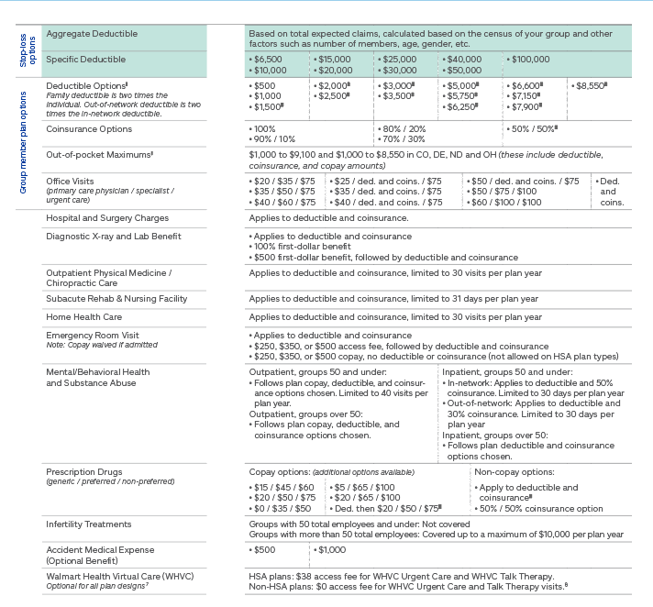
Plan design options
Options may vary by third-party administrator and state.
Notes:
Prescription copay options available.
First-dollar Accident Medical Expense options
HSA-compatible plans
Preventive care coverage aligns with Affordable Care Act requirements.
Urgent-care and emergency room copay options.
First-dollar diagnostic x-ray and lab options.

Slide 25
Meritain copay plans
Network access with efficient administration and support.
Zero-deductible plan with 50% coinsurance in network.
HSA-compatible plan with two deductible options and 0% coinsurance in network.

Slide 26
Added features

Slide 27

Walmart Health Virtual Care
Virtual Urgent Care and Talk Therapy visits are available through Walmart Health Virtual Care.
Urgent Care: U.S. board-certified doctors and medical providers are available 24/7/365 to diagnose, treat, and prescribe medication for many minor illnesses and injuries via phone and/or video visits.
Talk Therapy: For members 18 years+. Licensed therapists can help with a wide range of mental and emotional health needs. Receive ongoing support, on your schedule, from the comfort of your home via phone and/or video visits in as little as 48 hours.
* Walmart Health Virtual Care (WHVC) is formerly known as MeMD®. WHVC is not available in Washington, except through our Core Value plans.
Notes:
$6 PEPM for PPO plans
Included with Core Value plans
HSA plans: $38 access fee for WHVC Urgent Care and WHVC Talk Therapy.
Non-HSA plans: $0 access fee for WHVC Urgent Care and Talk Therapy visits

Slide 28

Vitality®
A simple, intuitive program with scientifically and clinically proven elements that promote healthy lifestyles.
Vitality is available to members and spouses and includes:
Vitality Health Review: A short, confidential assessment on current health and habits.
Vitality Check: A confidential biometric screening.
Vitality Points and Status: Employees choose healthy activities to earn Vitality Points for a higher Vitality Status and rewards.
Rewards: Employers decide which reward options to offer to employees.
Not available in WA.
Notes:
Vitality is not available in WA.

Slide 29

Activity tracker credit
This innovative program allows members to connect their fitness devices to Allstate Benefits.
Includes popular devices like Fitbit®, Garmin®, and Apple Health.
Encourages a healthy workforce.
This option is available through the Allstate Benefits Online Enrollment platform.
Clients can save up to 5% on their health care coverage costs when members connect.
Member must connect at time of application for Plan savings to apply.

Slide 30
Working with us

Slide 31



Who we are
For over 75 years, we’ve been providing insurance solutions in various lines for both personal and professional customers and businesses, focusing on unique markets and distributions.
¹
#72 on
FORTUNE 100
Publicly traded
Allstate (ALL)
*No. 3 in Property and Casualty category, https://fortune.com/ranking/worlds-most-admired-companies/2021/

Slide 32

Partnership
When you work with Allstate, you get the confidence of knowing you’re partnering with a company that offers years of experience and financial stability.
8,500 Employees
working for you
Underwriting Companies
Rated A+ (Superior)
$4.6 Billion
of revenue in 2018

Slide 33
Account management team
Our trusted account management team is available to keep the employer’s plan running smoothly. They’re here to help by:
Overseeing plan administration.
  Providing training and resources.
  Answering questions.
  Quickly resolving service issues.
Dedicated Account Manager to assist you and your client through the reissue process.
  Provide consultation regarding alternate plan options to optimize cost savings and benefits.
  Plan reviews to understand how the plan is performing, so there are no surprises at reissue.

Slide 34
Account management team
Helping you and your client understand state and federal fee requirements.
  We’ll help you administer these fees.
Quarterly newsletters for employers.
  Reporting reminders or updates.
  Account management reminders.
  Healthy living tips.
  Valuable add-ons, and more.

Slide 35
Submitting business

Slide 36
Submitting business
At Allstate Benefits, we make submitting business easy. Our experienced underwriters provide you and your clients:
Fast and reliable turnaround times.
Flexibility to find solutions that work for your clients and their groups.
*NEW* online enrollment tool.
  No hands-on administration for clients.
  No paper forms to collect and submit.
  Employees enter their own information, which ensures accuracy and speeds up the process.

Slide 37
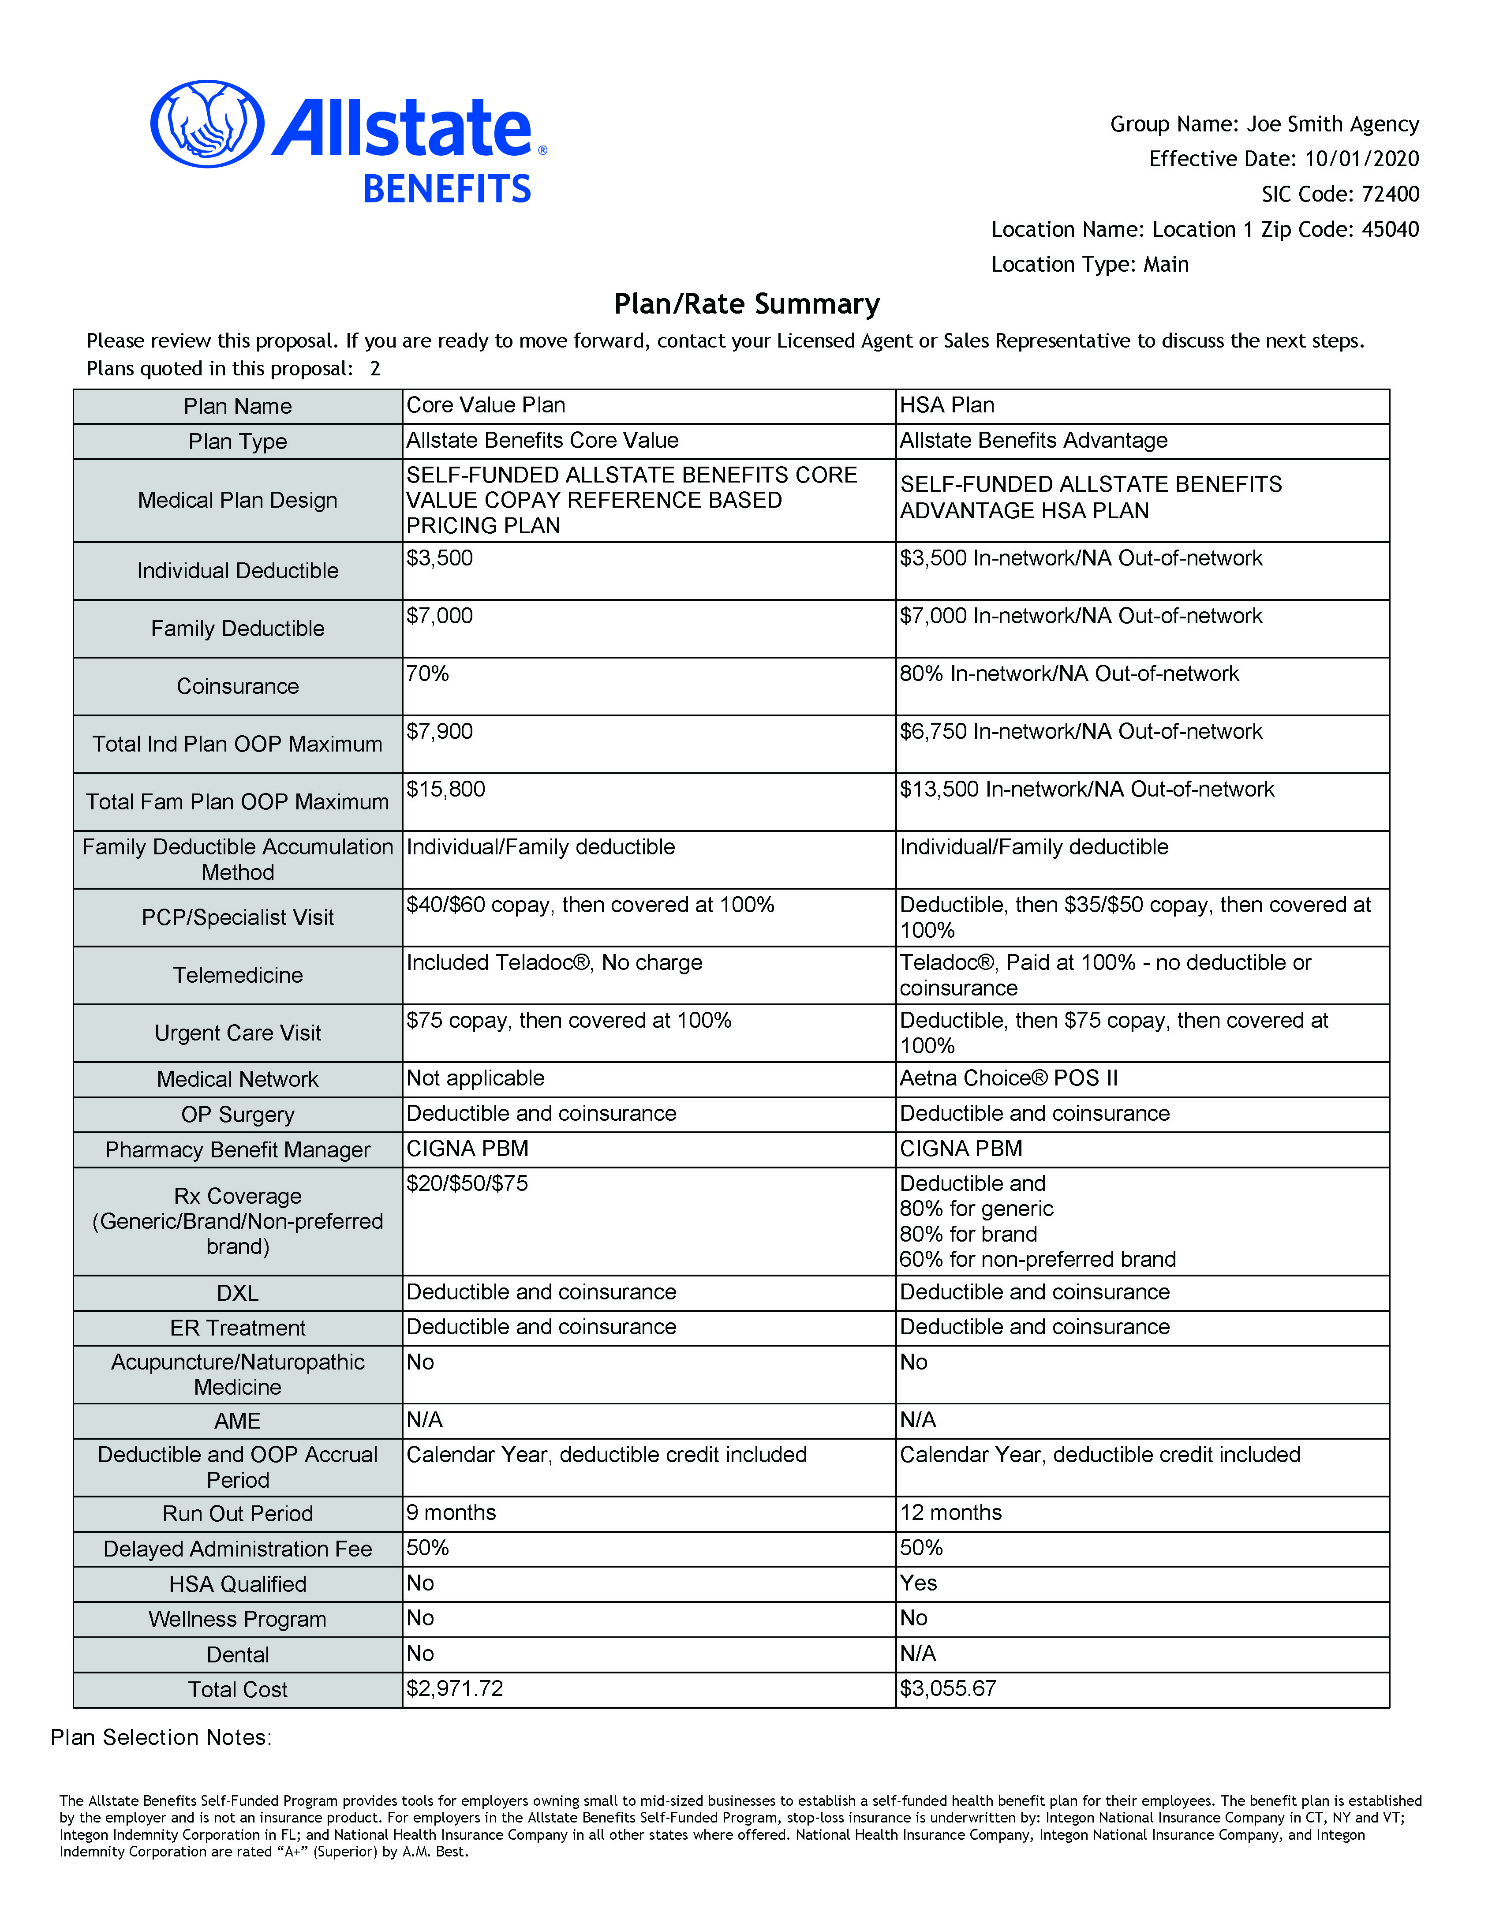
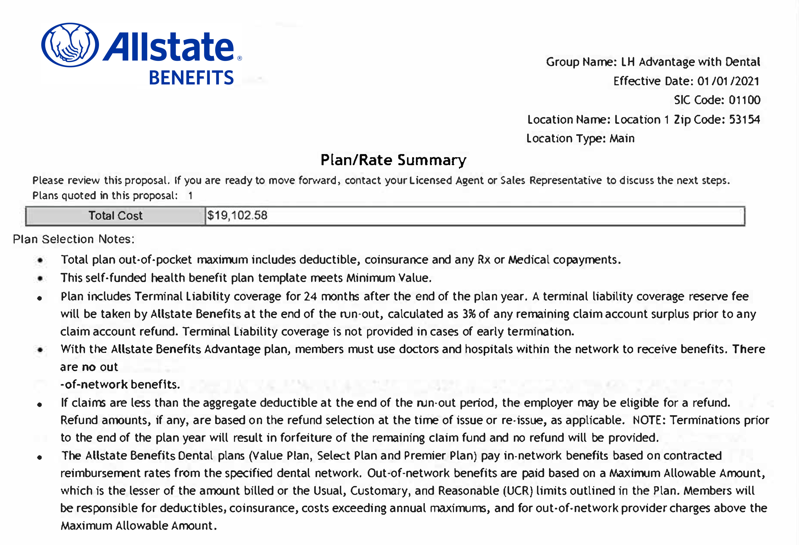
Quote proposal

Slide 38
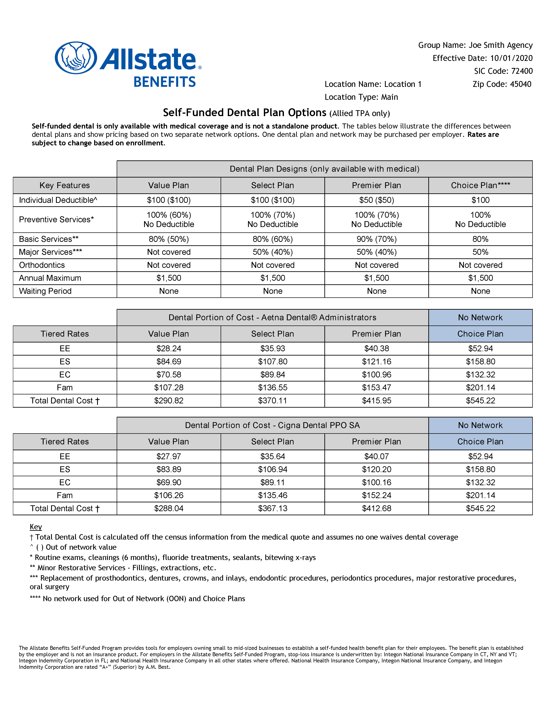
Dental options

Slide 39
Post sale

Slide 40
After the sale
A welcome email to the new groups includes:
  A link to a video introducing the account manager.
  A list of key contacts.
  Links to the employer portal.
  A copy of the employer guide.
  An overview of additions, terminations, billing, and more.
Agents get a copy of employer communications in their own inbox.

Slide 41

Allied Benefit Systems portal
At AlliedBenefit.com, members can:
  Check claims status and view EOBs online.
  View ID cards and other plan documents.
  Find in-network doctors and hospitals.
  Estimate costs of services and prescriptions.
  Compare providers.

Slide 42
Allied Benefit Systems portal
Reporting available at AlliedBenefit.com:
  Monthly invoices.
  Claim summary (claim detail by member).
  Reissue quotes.
  Census report.
  Claim fund summary report.

Slide 43

Meritain portal
At Meritain.com, members can:
  Check claims status and view EOBs online.
  View ID cards and other plan
  documents, such as SBCs and SPDs.
  Find in-network doctors and hospitals.
  Estimate costs of services.
  Compare providers.

Slide 44
BenefitSolver portal – Meritain
Reporting available at BenefitSolver.com:
  Monthly invoices.
  Reissue quotes.
  Census report.
  Claim fund summary report.

Slide 45
That’s a wrap.

Slide 46
Recap of our Self-Funded Program
One predictable monthly payment.
Plan administration and support.
Stop-loss limits financial exposure.
ACA compliant.
Nationwide product availability.
Variety of plans and options.
Tools and resources to help your clients.
Notes:
One predictable monthly payment – employers pay a fixed amount each month.
Complete plan administration and support – before, during, and after the sale.
Compliant with applicable ACA requirements.
Stop-loss minimizes the employer’s financial exposure.
Nationwide product availability.
Broad product portfolio with options to meet the needs of many employers.
Tools and resources that make reporting and managing health care coverage easy for your clients.

Slide 48
Thank you!
Allstate Benefits is a leading provider of employee benefit solutions in the U.S. and Canada and is rated A+ by A.M. Best. We protect more than 8 million individuals with innovative self-funded group health products and top-rated supplemental insurance products. Allstate Benefits is proud to be part of The Allstate Corporation (NYSE: ALL), a Fortune 100 company and the nation’s largest publicly held personal lines insurer. Allstate Benefits helps deliver the Good Hands® promise every day with the name that many know and trust. Learn more at www.allstatebenefits.com.
The Allstate Benefits Self-Funded Program provides tools for employers owning small to mid-sized businesses to establish a self-funded health benefit plan for their employees. The benefit plan is established by the employer and is not an insurance product. Allstate Benefits is a marketing name for: Integon National Insurance Company in CT, NY and VT; Integon Indemnity Corporation in FL; and National Health Insurance Company in CO, WA and all other states where offered. For employers in the Allstate Benefits Self-Funded Program, stop loss insurance is underwritten by these insurance companies in the noted states.
For agent use only. Not for distribution to consumers.
ABGH_SF_2158 (Rev. 01/2023) © 2023 Allstate Insurance Company. www.allstate.com or allstatebenefits.com

