Slide 1
PRAM INSURANCE SERVICES, INC.
PRODUCT PRESENTATION

Slide 2
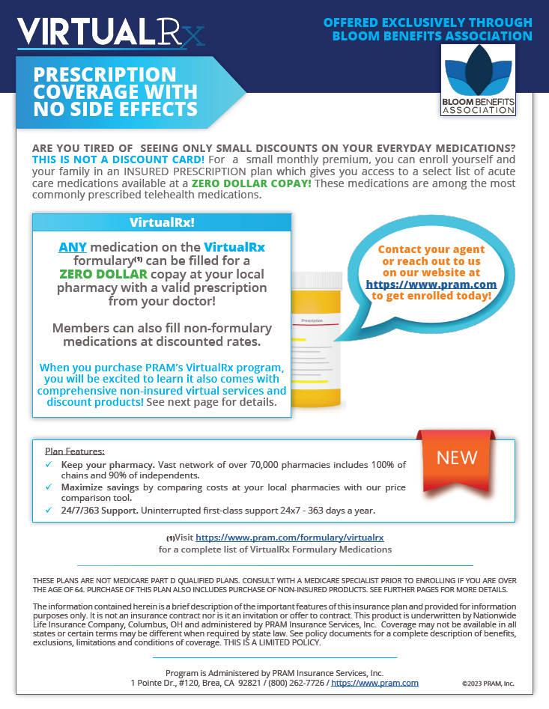
PRAM’s All New Virtual Insured Product!

Slide 3
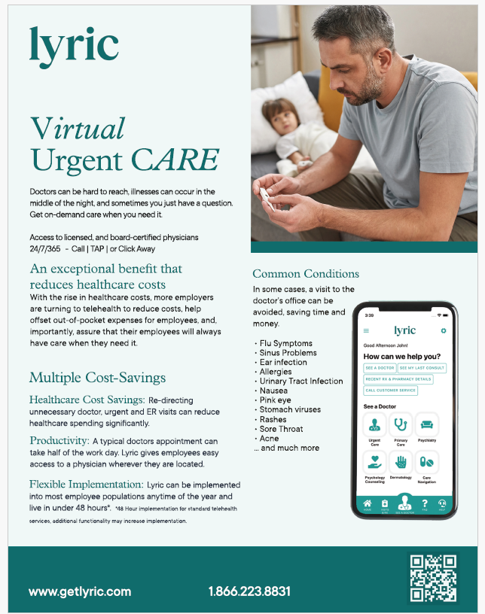
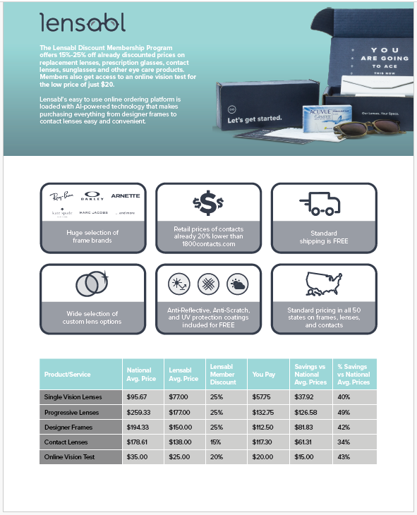
Virtual Benefits

Slide 4
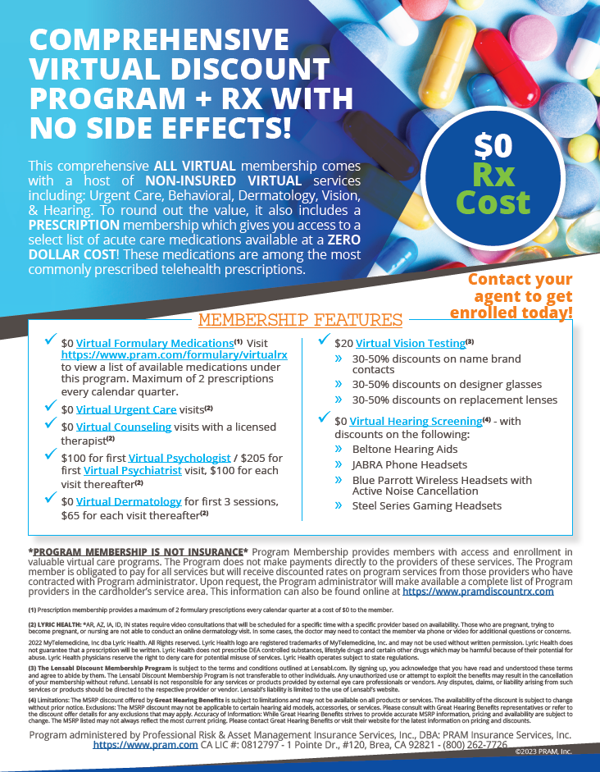
PRAM’s All New Virtual Non-Insured Product!

Slide 5
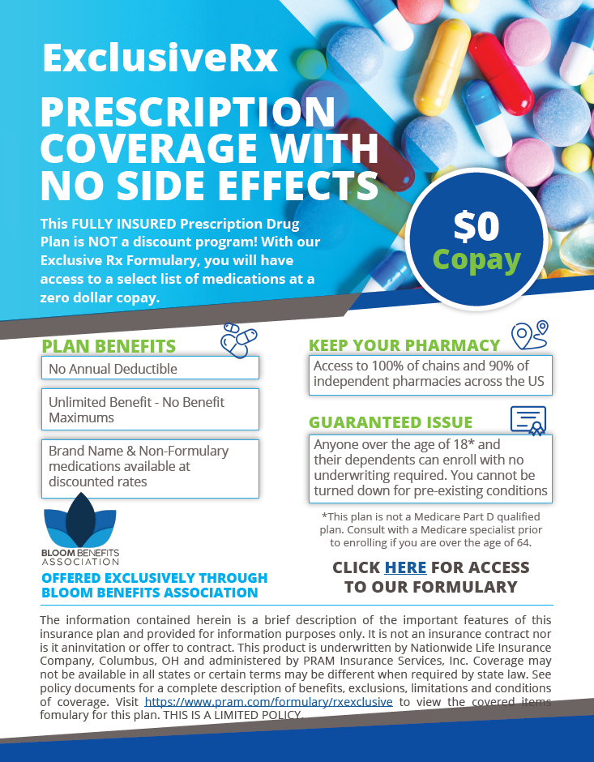

Slide 6
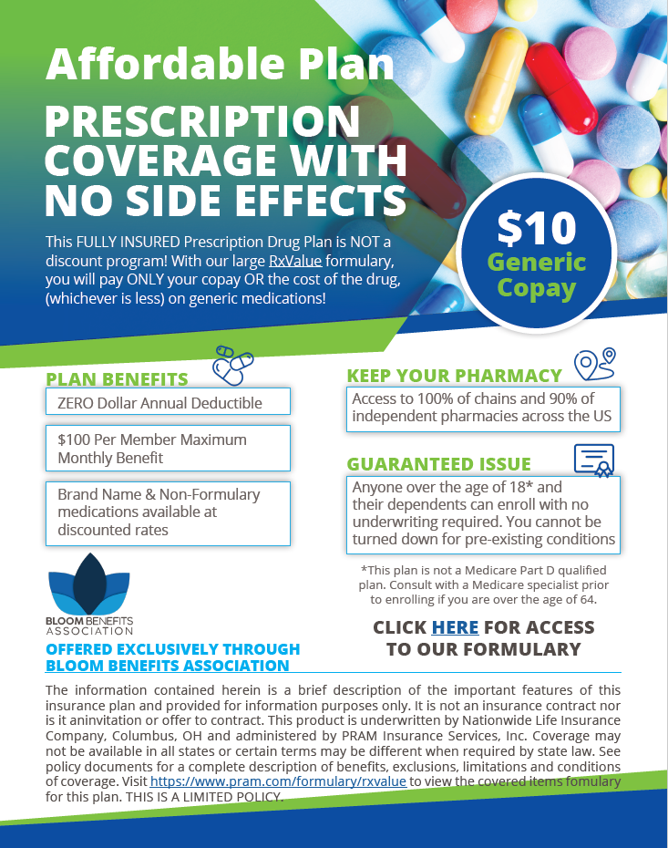
Affordable Plan

Slide 7
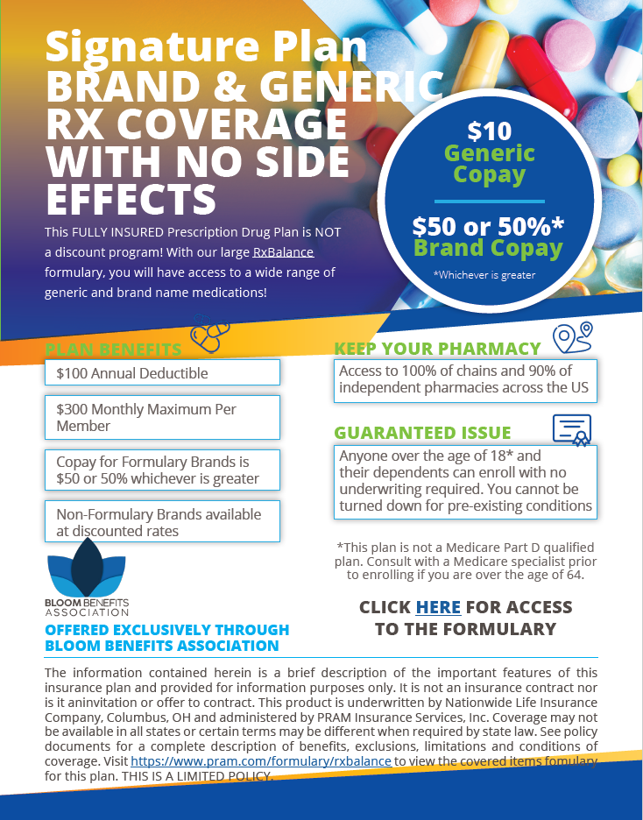
Signature Plan

Slide 8
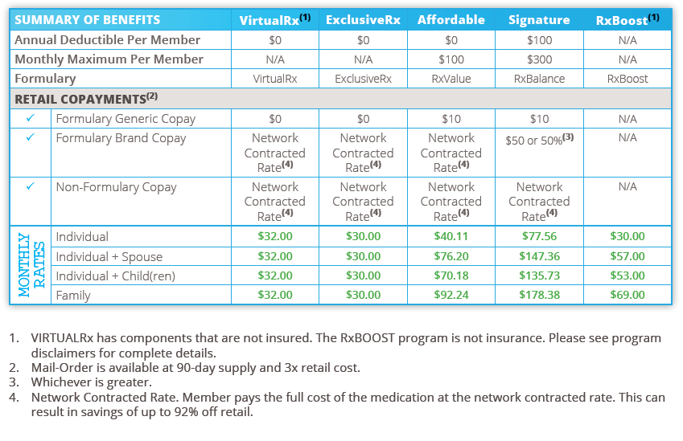
Individual Monthly Rates

Slide 9
Plan Administration – Set Up - Enrollment
Group Set Up
New Group Application
Account Manager sets any necessary meetings.
PRAM system set up
Eligibility File set up
PBM Set up
Fulfillment (if required) SFTP Set Up
Invoice/Billing Schedule
ACH Payment Set Up
Individual Enrollment
Agent Enrolls Member in PRAM Portal under Agent Dashboard.
Agent completes member application
Agent can also invite the member to self enroll by sending a link via email thru the agent portal.
Member receives verification email and completes the verification of enrollment.
Member Receives the New member Welcome Packet with information on Portal Access, ID cards, Plan Information, Formularies, etc.

Slide 10
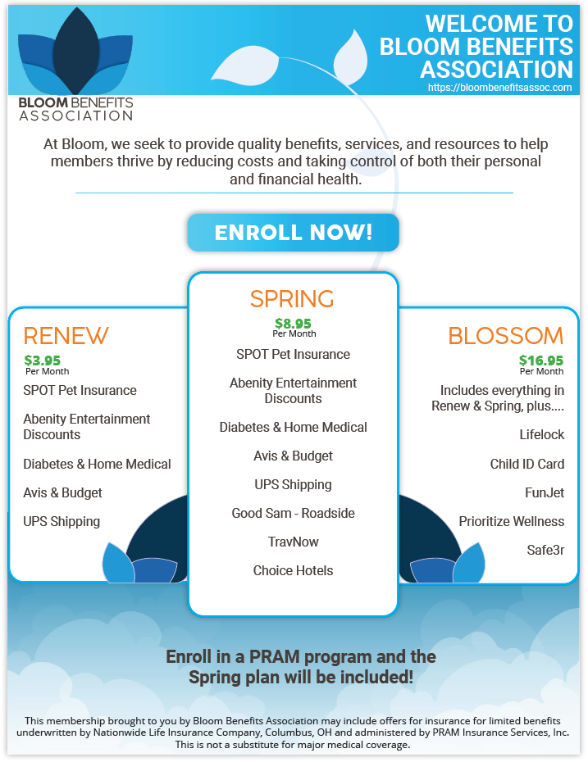
Bloom Benefits Association

Slide 11
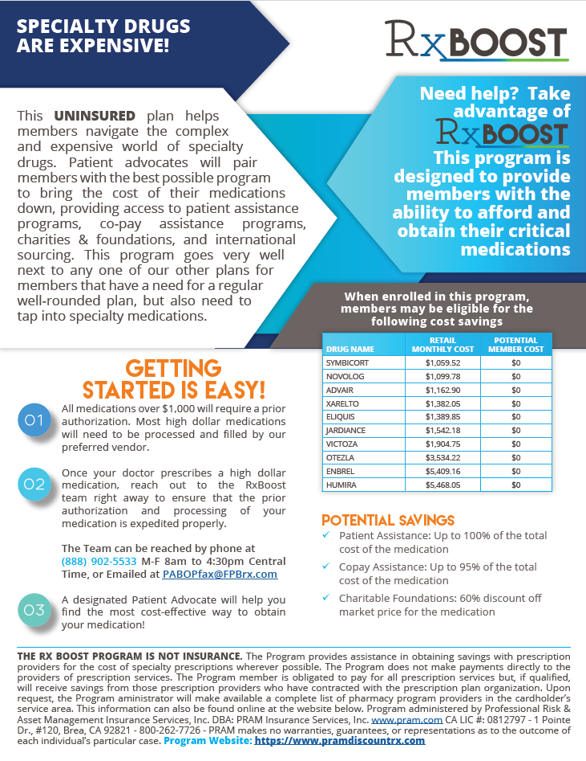
RxBoost Program

Slide 12
PRAM is going GREEN!!!
Introducing...
MONTHLY RATES | CBD ONLY | THC ONLY | CBD + THC
Member | $19.95 | $24.95 | $26.95
Member + Spouse | $27.90 | $32.90 | $34.90
Member + Child(ren) | $27.90 | $32.90 | $34.90
Family | $35.90 | $40.90 | $42.90
Benefits
Massive savings No copays
No deductibles
Pre-existing conditions accepted Cancel anytime
Product delivery straight to your door

Slide 13
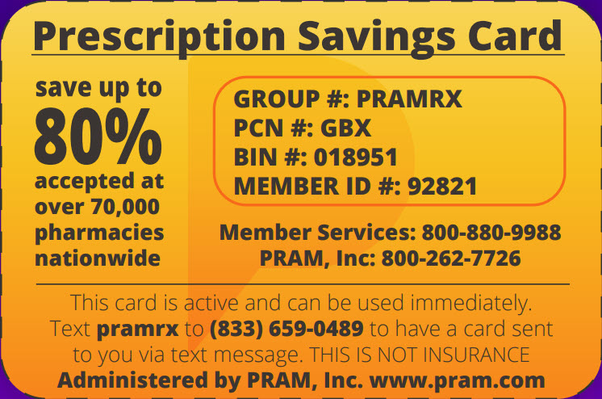
PRAM Rx Discount Card
Discounts of up to 80% available in over 70,000 pharmacies throughout
the United States!

