Slide 1
Core Value
02.01.2023

Slide 2
What We’re Going to Cover
What Is Core Value?
How Core Value Plans Work
Member Advocacy Program
Added Features
Plan Design and Benefits
Core Value Flex
Core Value Access
How to Use Core Value Plans
Application Requirements
Agent Training and Compensation
Common Questions
Notes:
What Is Core Value?
Reference-based pricing plans
State availability
Why Core Value plans
How Core Value Plans Work
Compared to self-funded PPO plans
Reimbursement rates
Plan Design and Benefits
Pharmacy, network, & preventive care
MeMD
Core Value Flex
Mid-year election
Core Value Access
Reference-based pricing with network access for physicians
How to Use Core Value Plans
Member ID card
Explanation of benefits
Added Features
Healthcare Bluebook
MeMD
Member Advocacy Program (MAP)
Application Requirements
Employer agreement
Agent Training and Compensation
Agent certification quiz
Compensation percentage

Slide 3
What is Core Value?

Slide 4
What Is Core Value?
What you want in a plan with the quality you expect
Core Value is a reference-based pricing plan that:
Determines benefits based on a multiple of the Medicare reimbursement rate or other derived equivalent.
Works without traditional medical provider networks.
Exceptions: pharmacy and transplants
Pays consistently regardless of what the doctor or facility charges.

Slide 5
Why Core Value?
Competitive pricing
Same versatile plan designs as our standard self-funded plans
Flexible plan options available
Core Value
Core Value Flex
Core Value Access
Member Advocacy Program (MAP) – A concierge service to assist in plan-related questions and negotiate balance bills with health care providers
Availability varies by state. See next slide for more details.

Slide 6
Now Available in 44 States!
Availability varies for Core Value Flex and Core Value Access. Core Value is only available in certain ZIP codes within Southern CA.
Notes:
We now offer Core Value in 45 states. Availability varies for Core Value Flex and Core Value Access. More details about this will be coming up further in the presentation.

Slide 7
Core value Plans: How they work

Slide 8
Core Value vs. Self-Funded PPO
 | Core Value Plans | Self-Funded PPO
Covered Charges/ Claim Costs | Deductibles, copays, coinsurance, and non-covered services | Deductibles, copays, coinsurance, and non-covered services
Pricing | May occur for amounts above the plan Maximum Allowable Amounts (MAA), in which case the Member Advocacy Team negotiates with the providers | May occur with out-of-network charges

Slide 9
Core Value vs. Self-Funded PPO
 | Core Value Plans | Self-Funded PPO
Network | No network restrictions, with the exception of pharmacy benefits and transplant services | Access to network providers
Benefits | Comprehensive major medical coverage | Comprehensive major medical coverage
Notes:
With Core Value, the plan reimburses the same amount — no matter which health care provider members choose.
The following services still rely on the use of network providers:
Pharmacy Benefits: Members must use the Cigna PBM Network — a network providing access to over 68,000 retail pharmacies.
Transplants: This plan uses a list of nationally recognized designated providers.

Slide 10
Core Value vs. Self-Funded PPO
 | Core Value Plans | Self-Funded PPO
Member Responsibility | Deductibles, copays, coinsurance, and non-covered services | Deductibles, copays, coinsurance, and non-covered services
Balance Bill For amounts in excess of deductibles, copays, and coinsurance | May occur for amounts above the plan Maximum Allowable Amounts (MAA), in which case the Member Advocacy Team negotiates with the providers | May occur with out-of-network charges
Notes:
Core Value Plans
Balance Bill
If this happens, the Member Advocacy Team works with the providers on negotiating an acceptable price

Slide 11
Core Value Plans
Reimbursement Rates
Type of Service | Reimbursement Rate
Office Visits | 130% of the Medicare reimbursement rate or derived equivalent
Inpatient | 150% of the Medicare reimbursement rate or derived equivalent
Outpatient | 130% of the Medicare reimbursement rate or derived equivalent
Prescriptions | Cigna PBM – works same as traditional, participating pharmacy coverage only

Slide 12
Core Value Plans
Reimbursement Rates
Type of Service | Reimbursement Rate
Dialysis | 100% of the Medicare reimbursement rate or derived equivalent
Transplants | Pre-authorization is required and members will be required to use designated providers
Other (such as DME or PME) | 130% of the Medicare reimbursement rate or derived equivalent

Slide 13
How Core Value Works
Example
In-office outpatient surgery
Deductible is met
Out-of-pocket is not met
80/20 coinsurance plan
Billed Charge for Covered Services
$3,500
Medicare Reimbursement Rate
$1,000
Plan Maximum Allowable Amount¹
$1,300
Plan Pays 80% Coinsurance
$1,040
Member 20% Coinsurance Responsibility
$260
Note: For illustrative purposes only, not a real case. | ¹130% of Medicare reimbursement rate.
Notes:
The remaining $2,200 that is not covered by the plan would be eligible for negotiation by the Member Advocacy Program if balance billed to the member.

Slide 14
How Core Value Works
Balance Billing
Most providers accept the allowed amount as a full and fair payment for the claim.
Balance billing occurs when a provider bills for amounts in excess of the plan Maximum Allowable Amount (MAA) and member responsibility.
Notes:
Provider negotiations come in when members are balance billed
Note: Not all balance bill amounts are eligible for the Member Advocacy Program, such as:
Non-covered charges
Assistant surgeon fees
Non-emergency use of an Emergency Room
Member cost sharing

Slide 15
How Core Value Works
Balance Billing
A balance bill:
Includes amounts billed for covered services that are above the MAA.
Does not include member responsibility, such as deductibles, copays, coinsurances, and charges for non-covered services.
If a member is balance billed the Member Advocacy Program will assist.
Notes:
SBC’s refer to balance bills as member responsibility - Deductibles, copays, coinsurance amounts and charges for non-covered services.
However, for purposes of the Core Value plan, a balance bill is in reference to charges in excess of member responsibility and plan MAA.
Next, we will take a deeper dive into the individualized support the Member Advocacy Program offers.

Slide 16
Member Advocacy Program

Slide 17
Member Advocacy Program
The Member Advocacy Program (MAP) Team is also available to:
Answer questions about benefits.
Provide claim-status updates.
Assist with billing questions.
Finding alternative providers if they do not choose to accept the plan.
Facilitate provider negotiations in cases of balance billing.
Notes:
The MAP team will also work with providers to educate them on how the plan works.

Slide 18
Member Advocacy Program
The Member Advocacy Program (MAP) Team is also available to:
Answer questions about benefits.
Provide claim-status updates.
Assist with billing questions.
Finding alternative providers if they do not choose to accept the plan.
Facilitate provider negotiations in cases of balance billing.
Notes:
The MAP team will also work with providers to educate them on how the plan works.

Slide 19
Member Advocacy Program
Any members receiving a balance bill should contact the Member Advocacy Program (MAP) right away.
Notes:
This is an example of what new Core Value Members receive the flyer walks then through the steps of what to do when they seek care and provides instruction on what to do when a balance bill event occurs.
When a balance bill is received, members must call the MAP team immediately. The team will:
Work with members to determine if the balance bill is their responsibility or for charges in excess of the plan MAA.
Work with the provider to negotiate balance-billed amounts that are in excess of the plan MAA.

Slide 20
Balance Bill Notification Flyer
Members will receive a letter each time a balance bill is negotiated and a new payment is sent to the provider.
The letter:
Advises members that an additional payment was made on the claim.
Tells members what to expect next.
Notes:
With the Core Value plan, we help members every step of the way to ensure they know exactly what to expect when negotiations with Balance Bills occur.

Slide 21
Core Value Plans: Value Added Features

Slide 22
Healthcare Bluebook
Included with Core Value and Core Value Flex¹
Helps members access quality health care at a fair price.
Easy-to-use tool for plan members to shop around for low-cost, high-quality ‘green’ providers.
When members use green providers it lowers overall claims costs.
¹Not available with Core Value Access plans.

Slide 23
Healthcare Bluebook
Did you know?
Prices for the same procedure can vary up to 500% depending on where you go.
The choice is clear!

Slide 24
Healthcare Bluebook
How the Tool Works
Members search for a procedure.
The tool lists providers ranked by quality and cost.
Members are encouraged to select a provider with a green Fair Price™ indicator.
Note: There is no correlation between the Healthcare Bluebook Fair Price™ service and a provider accepting the payment made by the Core Value plan.

Slide 25
Telemedicine
Walmart Health Virtual Care (WHVC) is formerly known as MeMD®. WHVC Urgent Care visits and Talk Therapy visits are available via phone and/or video visits
WHVC Urgent Care
U.S. board-certified doctors and medical providers are available to diagnose, treat, and when medically necessary, prescribe medication for many minor illnesses.
WHVC Talk Therapy (Ages 18+)
Licensed therapists help with a wide range of mental and emotional health needs.
Medical care is available 24/7 and therapy visits can be scheduled in as few as 48 hours
Notes:
WHVC consultations can treat many conditions, including: cold and flu, allergies, pink eye, ear infections, sinus and respiratory problems, and more.

Slide 26
Telemedicine
Core Value includes access to WHVC
Non-HSA plans: $0 access fee for WHVC Urgent Care and Talk Therapy visits.¹
HSA plans: $38 access fee for WHVC Urgent Care and WHVC Talk Therapy.²
1 Includes up to three WHVC Urgent Care visits per individual per month and five WHVC Talk Therapy visits per individual over the age of 18 per month.
2 Fee applies to deductible and out-of-pocket maximums.

Slide 27
Vori Health
A new and better muscle and joint pain care model
A nationwide specialty medical practice delivering virtual-first muscle and joint pain solutions to help members get back to their lives faster. With Vori Health, members get treatment from a specialty physician, physical therapist, and health coach who work together to manage all aspects of care. This holistic model reduces unnecessary surgeries, lowers spend, and improves outcomes.

Slide 28
Why Vori Health
A problem with the status quo
Musculoskeletal (MSK) spending has been the No. 1 or No. 2 expense for the last decade.
15% of all health care was spent on MSK in 2021
Up to 40% of MSK surgeries are unnecessary
Pain is No. 1 cause of disability
7x higher surgery rate for members who go from PCP to imaging to surgeon
MSK spending increases every year, yet outcomes don’t improve
Statistics from Vori Health
50% of employees experience chronic MSK pain each year

Slide 29
Vori Health Availability
Included with all core value plans
Included with all Core Value, Core Value Flex and Core Value Access plans*
$0 Member Copay on all initial evaluations
$0 Member Copay on all lumbar and/or knee 12-month treatment plans
All other covered Vori Health services are subject to deductible and coinsurance
*Available with new business and reissues with effective dates of 1/1/2023 and later

Slide 30
Vitality®
Vitality® is a simple, intuitive program with scientifically and clinically proven elements that promote healthy lifestyles.
Vitality® is available to members & spouses with:
Vitality Health Review
Vitality Check
Confidential biometric screening.
Vitality Points and Status
Earned by completing healthy activities.
Rewards
Employers decide which reward to offer to employees.

Slide 31
Activity Tracker Credit
This innovative program allows members to connect their fitness devices to Allstate Benefits.
Includes popular devices like Fitbit®, Garmin®, and Apple Health.
Encourages a healthy workforce.
This option is available through the Allstate Benefits Online Enrollment platform.
Clients can save up to 5% on their health care coverage costs when members connect!
Member must connect at time of application for Plan savings to apply.

Slide 32
Core Value Plans: Design & Benefits

Slide 33
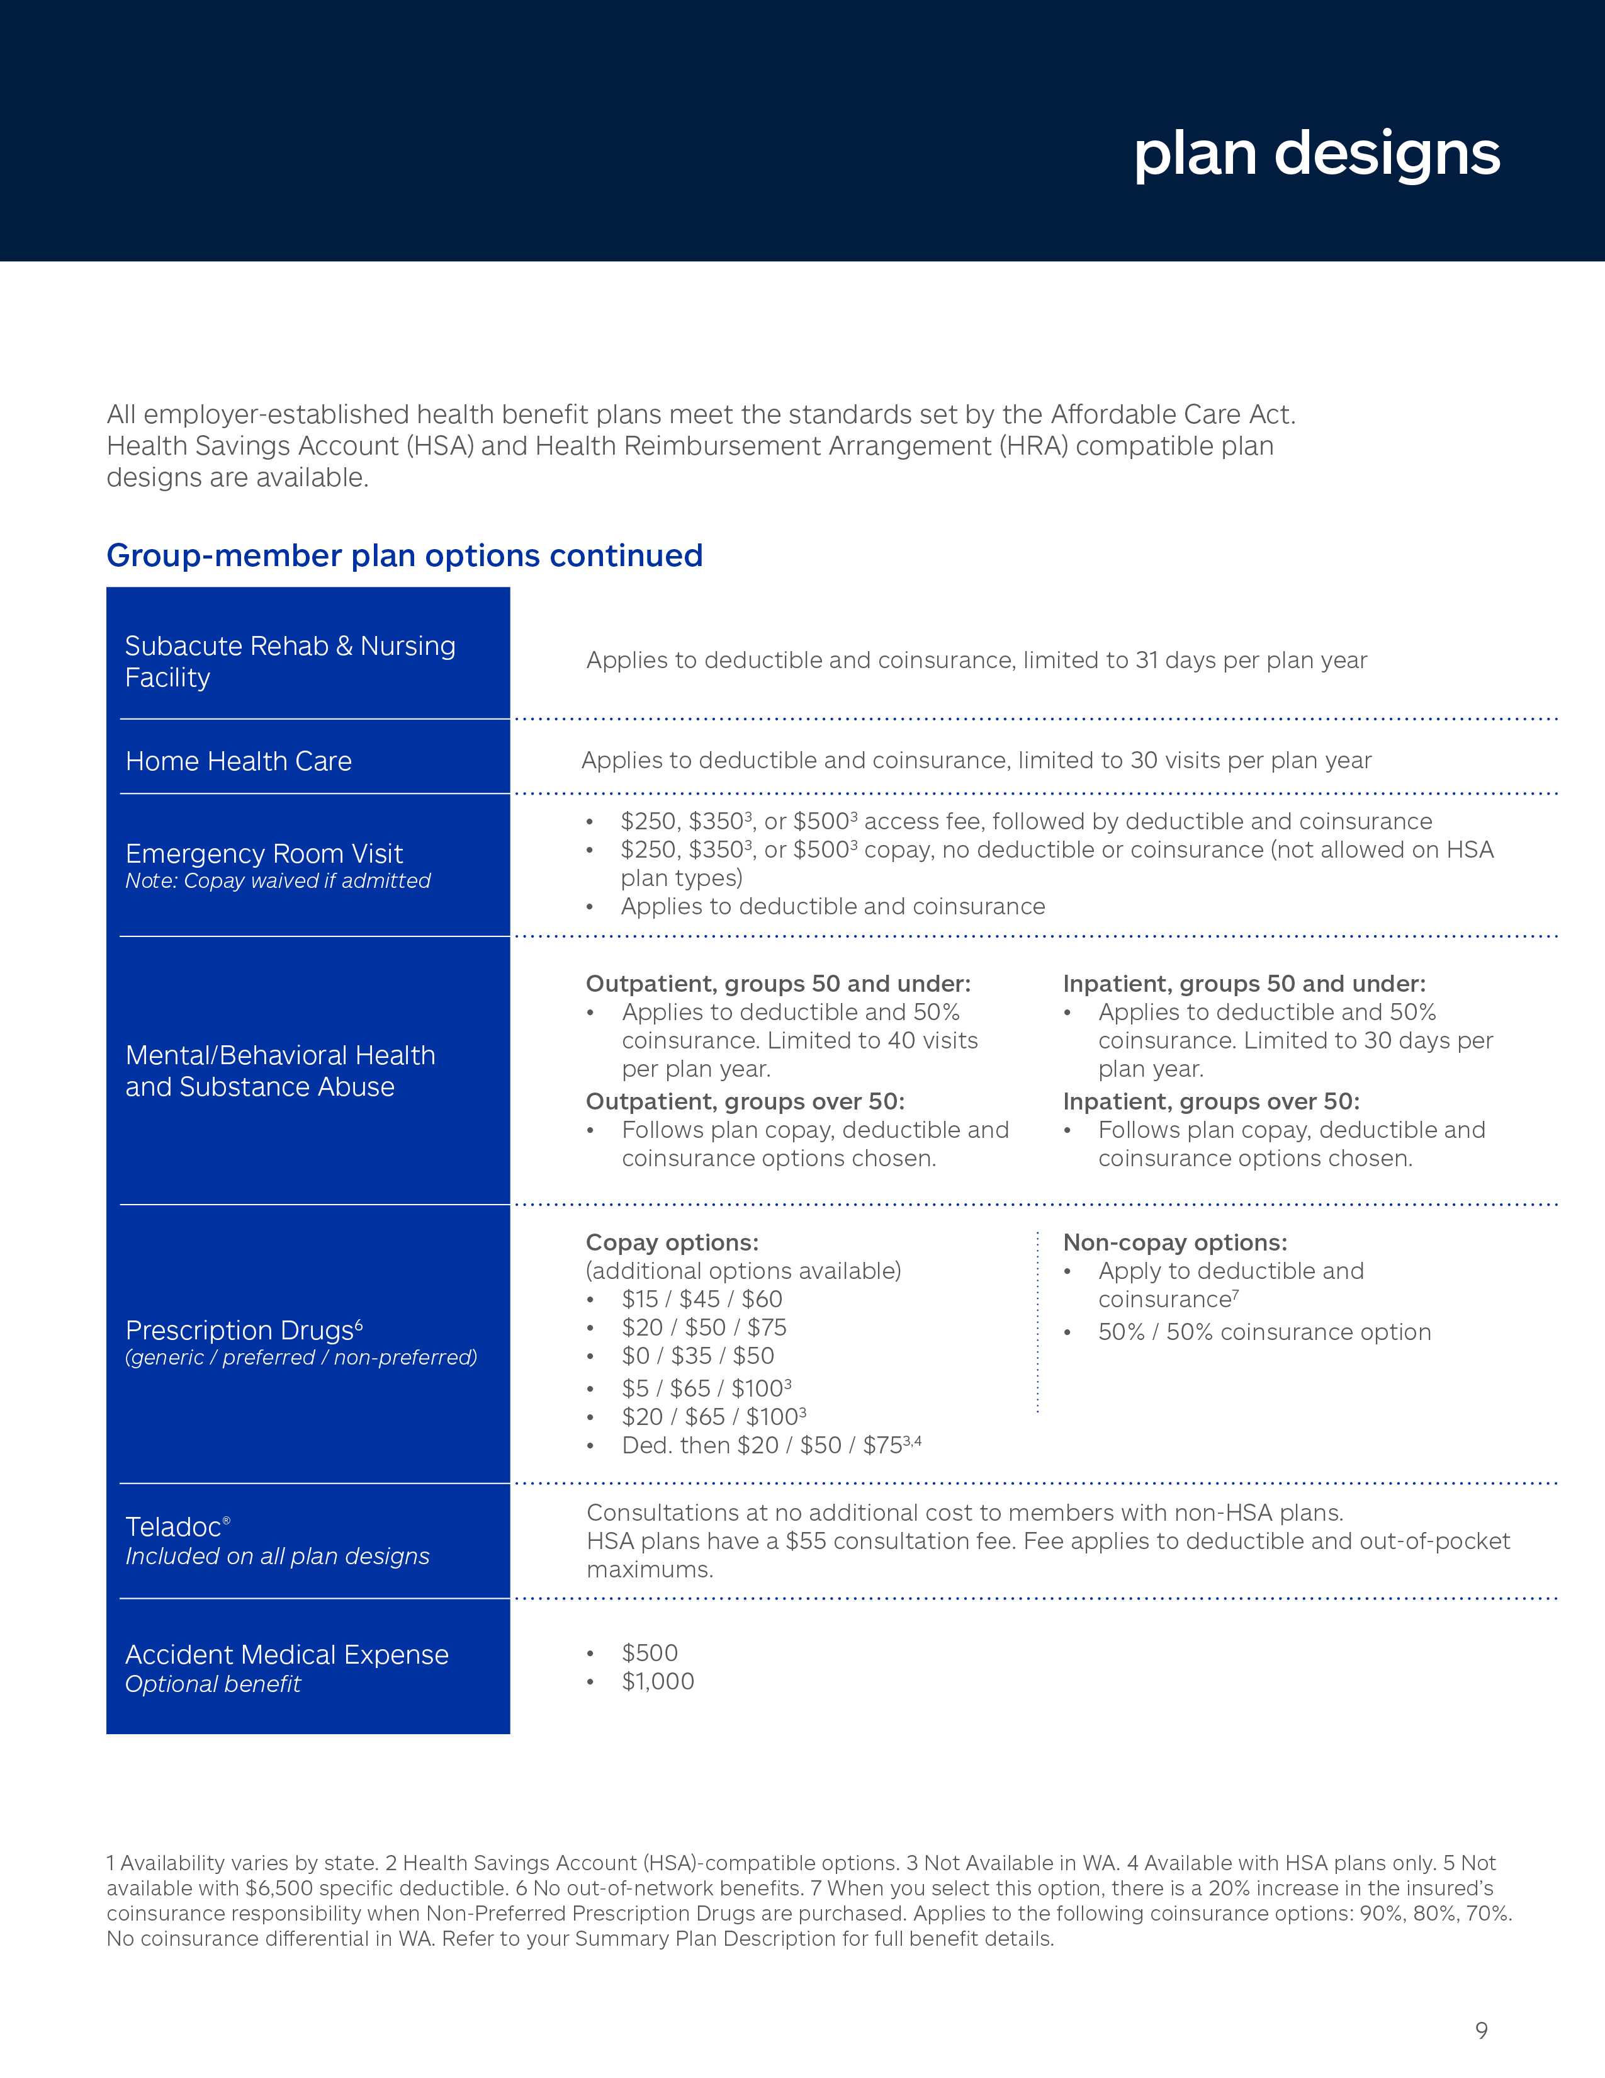
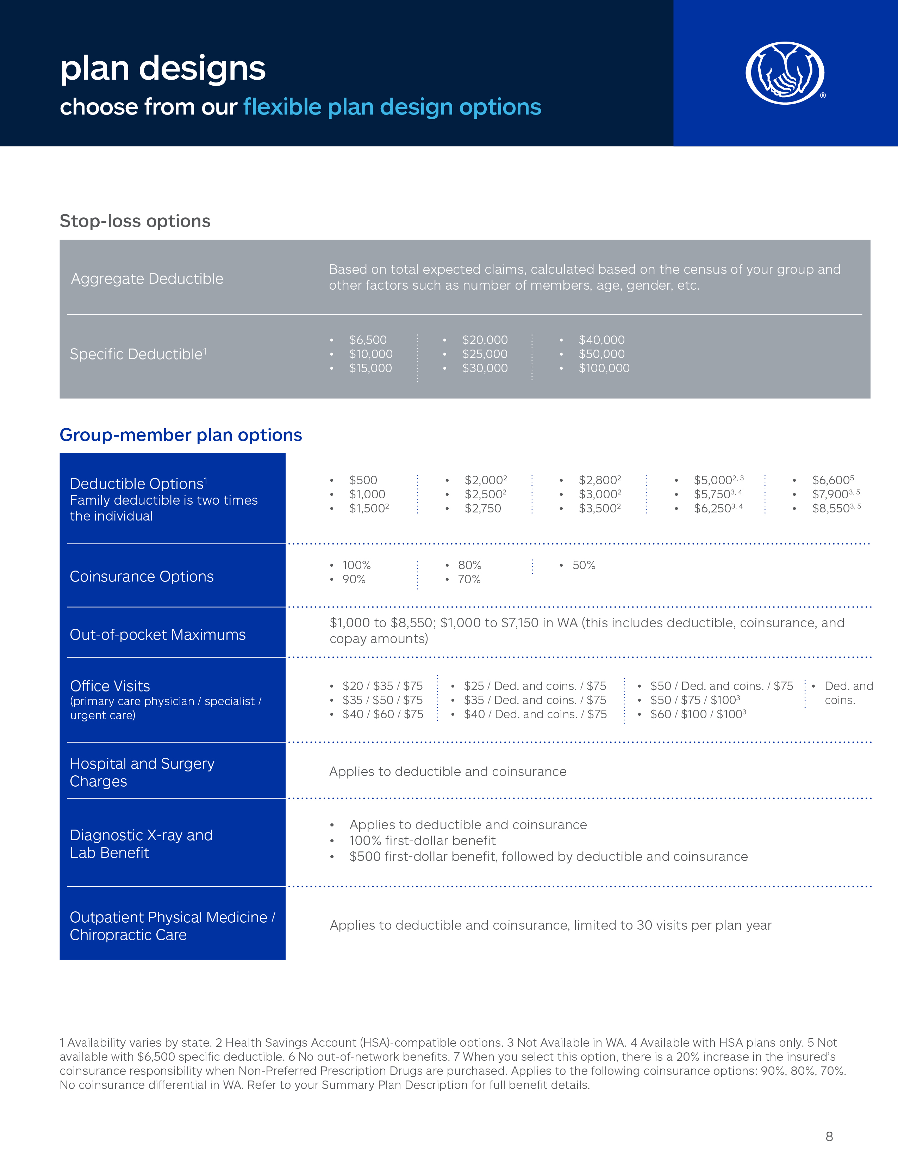
Plan Design Options
Same versatile plan options available as all of our self-funded program offerings

Slide 34
Plan Design Options
Additional protection with Terminal Liability Coverage
Terminal Liability Coverage¹
Included
Included run-out period¹
9 Months
Additional protection beyond the run-out period
15 Months
Total Added Protection
24 Months
¹Exceptions apply to certain stop-loss plan designs for 51+.
Notes:
For an additional 15 months of protection beyond the run-out period.
Total of 24 months of added protection.

Slide 35
Plan Administration
Core Value plans utilize Allied as the TPA.
Allied Benefit Systems, LLC, has more than 30 years of experience in benefit management and administration services.

Slide 36
Plans without a Network
There are no medical networks associated with Core Value.
No out-of-network penalties.
With Core Value, the plan reimburses the same amount — no matter which health care provider members choose.¹
In rare cases, because Core Value does not use a network there is potential that a provider may turn away a member.
In these instances, the MAP team will assist the member to find a provider that does accept the plan.
¹Exceptions: For transplants, members select from a list of designated providers. For pharmacy, the plan utilizes CIGNA PBM.

Slide 37
Pharmacy Benefits
Cigna PBM
Same as our other self-funded plan options.
No benefits for non-participating pharmacies.
What happens when a specialty medication falls under medical coverage?
Medications are repriced at 130% of the Medicare reimbursement rate or derived equivalent.¹
Benefits are subject to deductible and coinsurance.
¹For infusion claims over $1,500 the Plan reimburses at 100% of Medicare.

Slide 38
Preventive Care Benefits
Certain preventive services, as required by the Affordable Care Act (ACA), are not subject to deductible and coinsurance, same as other program options.
Paid at a percent of the Medicare, or derived equivalent, reimbursement rate.

Slide 39
ACA Requirements
Core Value:
Meets the Minimum Value requirement.
Meets Minimum Essential Coverage requirement.

Slide 40
Core Value: The Flex Option

Slide 41
Core Value Flex
Core Value Flex option allows employers to choose a Core Value reference-based pricing plan with the option of switching to a PPO network mid-year — without a change in their monthly payment.
Note: Not available in WA and CA.
Notes:
Core Value Flex option allows employers to choose a Core Value reference based pricing plan with the option of switching to a PPO network mid-year — without a change in their monthly payment.

Slide 42
Core Value Flex
If an employer elects to use the Flex option and change to a PPO network mid-year, they will work with their Account Manager and:
The plan change will not impact the monthly payment.
The new PPO network is selected from approved networks at time of plan change.
Standard network rules apply.
Aetna Signature Administrators® network is not available for the Flex option.
Notes:
The Flex option allows employers to choose a Core Value reference based pricing plan with the option of switching to a PPO network mid-year — without a change in their monthly payment

Slide 43
Core Value Flex
Election to Flex can be made in month 4 or 5 of the plan year.
Submissions cannot be accepted after month 5.
Members must be notified of change 60 days in advance.
The plan change will be effective the first day of month 7 or 8 depending on when the election was submitted.
Core Value accumulators carry forward to the in-network out-of-pocket maximums.
Plan members will receive new plan documents and ID cards.

Slide 44
Core Value Flex
The plan run-out converts to 6 months, like PPO plans.
Claims incurred while the Core Value plan is in place are:
Processed as Core Value.
Eligible for MAP negotiations.
Claims incurred on or after the effective date of the plan change to PPO are:
Processed as PPO claims.
Are not eligible for MAP negotiations.

Slide 45
Core Value Flex State Availability
Notes:
Core Value Flex is available in 45 states - all Core Value states except California and WA.

Slide 46
Core Value Access

Slide 47
Core Value Access
Core Value Access is a win-win:
Employers experience the savings potential of a Core Value reference-based pricing plan.
Employees get access to a network for physicians¹
PHCS Practitioners and Ancillary network or Prime Health Physician Only Network.
When members use a network physician they won’t be balance billed and are ensured that the provider will accept the plan.
¹Network availability varies by state.

Slide 48
Core Value Access
Out-of-network professional claims get processed under the standard Core Value plan benefit design with:
One benefit tier – no penalties for going out-of-network.
Access to the Member Advocacy Program (MAP).

Slide 49
PHCS Practitioner & Ancillary Network
With the PHCS Practitioner & Ancillary network, members get:
Choice – Broad access to more than 814,000 practitioners.
Savings – Negotiated discounts result in significant cost savings when visiting PHCS physicians.
Quality – Rigorous provider criteria and credentialing helps assure employees that they are choosing their physician from a high-quality network.
Clients access the PHCS Practitioner & Ancillary Only Network through Multiplan.
Notes:
PHCS is the largest primary PPO in the nation and offers secured network discounts on PHCS physician claims.

Slide 50
Prime Health Network
With the Prime Health Physician Only Network, members get:
Choice – Prime Health’s flagship broad-based Preferred Provider Organization (PPO) network is comprised of over 700,000 medical providers across the U.S.
Savings – Competitive rates and goals to control medical expenses for you and your members.
Quality – Focus on developing provider networks that meet the specific needs of individuals.
Clients access the Prime Health Physician Only Network through First Health.
Note: Prime Health Network is only available in IN, WY, and Dallas, TX.
Notes:
Prime Health Network is only available in IN, WY, and Dallas, TX.

Slide 51
Core Value Access State Availability
Core Value Access is only available in certain ZIP codes within Southern CA.
Notes:
Prime Health is only available in IN, WY and Dallas, TX
Core Value Access is only available in certain ZIP codes within Southern CA

Slide 52
Core Value Plans: How To Use Them

Slide 53
How to Use Core Value
Members can obtain services with the Core Value plans the same way they do any other plan.
Members should present ID card at the time of service just like any other plan.
No additional verification is needed.
If a provider has questions about how the program works, they should contact the MAP team directly.
Notes:
Sometimes there is confusion is around “Medicare”, and the false perception that this is a Medicare plan
If the plan is ever questioned by a provider, the member can:
Direct the provider to call the Member Advocacy Team and the Member Advocacy Team will work with the provider – in many cases this is easily and quickly resolved

Slide 54
Member ID Card
Example

Slide 55
Vori Health
A new and better muscle and joint pain care model
A nationwide specialty medical practice delivering virtual-first muscle and joint pain solutions to help members get back to their lives faster. With Vori Health, members get treatment from a specialty physician, physical therapist, and health coach who work together to manage all aspects of care. This holistic model reduces unnecessary surgeries, lowers spend, and improves outcomes.

Slide 56
Member Flyer
example
When the member receives their ID Card, this flyer is included to explain the Member Advocacy Program and when to call.

Slide 57
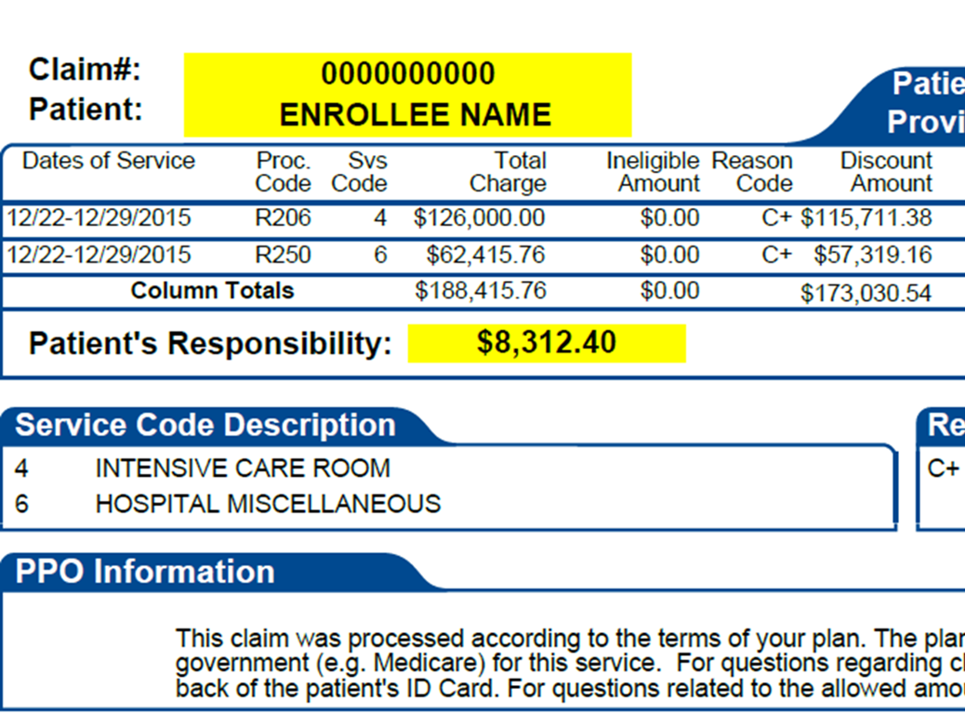
Explanation of Benefits
example
Ineligible Amount:
Shows charges for any non-covered services.
Discount Amount:
Shows the amount in excess of the plan MAA or the network discount, in cases where a network is utilized.
Patient’s Responsibility:
Includes any deductible, copay, coinsurance amounts due, and any charges for non-covered services.
PPO Information:
Includes statement, “This is not a PPO Plan.”
1
2
3
4

Slide 58
Explanation of Benefits
example
This stuffer will be included with each monthly consolidated EOB that members receive.
It encourages members to:
Check each bill against the Patient Responsibility as shown on the EOB.
Call the MAP team right away if it doesn’t match up.
Notes:
With the Core Value plan, we help members every step of the way to ensure they know exactly what to do if a balance bill is received.

Slide 59
Core Value: Application Requirements

Slide 60
Application Requirements
A Core Value specific Employer Agreement is required.
Remainder of documentation is the same as the other Allstate Benefits Self-Funded Programs.

Slide 61
Agent Training & Compensation

Slide 62
Agent Training Requirements
Agents are required to complete the Agent Certification quiz at the following URL:
https://www.surveymonkey.com/r/ALLSTATEBENEFITS-COREVALUECERT
Certification requirement will be checked at time of underwriting.
Notes:
We’ll work with you to ensure you have the tools and training required to be able to sell our Core Value program.

Slide 63
Agent Compensation
Compensation is 1% higher than the traditional Allstate Benefits Self-Funded schedule.
The 1% will automatically be added to the writing agent’s compensation.
For non-direct paid, the compensation will be paid to the agency.
Dial up or down on compensation is allowed.
Reissue compensation is 1% lower than new business.

Slide 64
Core Value
Recap
Quality benefits
Member Advocacy Program
Healthcare Bluebook Tool
Rates are often lower than self-funded PPO plans
Access to MeMD®
Stop-loss insurance

Slide 65
Common Questions

Slide 66
Commonly Asked Questions
How will the experience differ from my current block of Allstate business with Allied?
The experience will be very similar to what you see when selling our Traditional or Advantage plans. Administration is through Allied, but Core Value has a dedicated customer service team. Allied Portal access remains the same and compensation payments will be handled the same as with our other plans.
How can I explain the balance bill process easily to my group’s employees?
Balance billing happens to out-of-network charges in a PPO plan as well. A provider may bill for amounts beyond what the plan determines is a reasonable fee for services. When this happens, it’s called a balance bill. With Core Value, the Member Advocacy Program (MAP) is available to work with the provider to remove the burden from the member.

Slide 67
Commonly Asked Questions
What are some examples of a balance bill that is NOT eligible for MAP?
Example 1: A member has a medically necessary office-visit surgery (covered service) and non-medically necessary cosmetic Botox injections (non-covered service) at the same visit. MAP will assist with any balance bill for the surgery, but the Botox charges are not eligible for MAP.
Example 2: A member goes to an emergency room for treatment of a cold (non-emergency treatment). The covered charges are subject to a 30% penalty for non-emergency use of an ER. The penalties, as well as any balance bill for the emergency room treatment, are not eligible for MAP.
Example 3: A member has a medically necessary office-visit surgery (covered service), and the provider bills the member for the amount not covered by the plan because it is attributable to the member’s deductible. Such amounts are not eligible for MAP.
However, in this instance, the member can call MAP to confirm whether such amounts should be paid by the member.

Slide 68
Commonly Asked Questions
What is the required timeline on reporting a balance bill to MAP?
Balance bills should be reported to MAP as soon as possible, but in no event later than 90 days from receiving the balance bill or the end of the TLO, whichever comes first.
What if an employee doesn’t report the balance bill to MAP?
MAP will not be initiated and the employee may continue to get billed from the provider without MAP assistance. It is essential for employees to call the Member Advocacy Program as soon as they receive a balance bill to avoid any future collection activity.

Slide 69
Commonly Asked Questions
What does a member need to do if a provider does not understand how the plan works or refuses to accept the member as a patient?
Ask the provider call the MAP team.
How can I ensure providers work with Allied/MAP and do not go directly to the employees?
The MAP program is typically initiated when an employee/member calls after having received a balance bill. The provider does not pre-negotiate charges. Educating the employer to help employees know what to do if a balance bill is received is critical to the member experience. Employee MAP flyers will be included with all ID cards and with each EOB delivery.

Slide 70
Commonly Asked Questions
Will the member’s credit score be impacted if the balance bill isn’t paid within 30 days?
The three major credit reporting agencies give consumers 180 days to pay their medical debt or resolve disputes before reporting the debt on a consumer’s credit report. However, it is essential for employees to understand they need to call the Member Advocacy Program as soon as they receive a balance bill to avoid any unnecessary delays.
How long does the claim negotiation process take?
The historic average with the program’s negotiation vendor is 5-7 days. However, depending on the provider’s response it could take longer.

Slide 71
Commonly Asked Questions
How can an employee effectively explain this is not a Medicare plan but a group plan?
The ID card shows this is an employer-sponsored group health plan. However, providers can be referred to the provider question phone number on the back of the ID card.
Are Core Value materials available in Spanish?
Plan documents are not available in Spanish at this time. However, the Member Advocacy Program (MAP) does have Spanish-language capabilities for benefit and claims assistance. MAP marketing materials are available in Spanish upon request to ensure Spanish speaking members understand how to utilize MAP.

Slide 72
Other Questions?
Please Contact:
[Contact Info]

Slide 73
Thank you!
Allstate Benefits is a leading provider of employee benefit solutions in the U.S. and Canada and is rated A+ by A.M. Best. We protect more than 8 million individuals with innovative self-funded group health products and top-rated supplemental insurance products. Allstate Benefits is proud to be part of The Allstate Corporation (NYSE: ALL), a Fortune 100 company and the nation’s largest publicly held personal lines insurer. Allstate Benefits helps deliver the Good Hands® promise every day with the name that many know and trust. Learn more at www.allstatebenefits.com.
The Allstate Benefits Self-Funded Program provides tools for employers owning small to mid-sized businesses to establish a self-funded health benefit plan for their employees. The benefit plan is established by the employer and is not an insurance product. Allstate Benefits is a marketing name for: Integon National Insurance Company in CT, NY and VT; Integon Indemnity Corporation in FL; and National Health Insurance Company in CO, WA and all other states where offered. For employers in the Allstate Benefits Self-Funded Program, stop loss insurance is underwritten by these insurance companies in the noted states.
For agent use only. Not for distribution to consumers.
ABGH_CV_2087 (Rev. 02/2023) © 2023 Allstate Insurance Company. www.allstate.com or allstatebenefits.com

