Slide 1
AMERICA’S CHOICE
AGENT TRAINING

Slide 2
Who are the Partners?
Marketing & Brand name of the Program
Third Party Administrator (TPA)
Process all payments & claims
Appear on all communication (Emails, Letters)
Insurance Carrier
A- Rated
Fastest Growing Stop Loss Carrier in Country - 6x
Owned by Alphabet Inc.

Slide 3
Who we serve
Individuals that run their own business
Self-Employed with no employees
Are in the gig-economy
Freelancers or Consultants
Do not qualify for large ACA subsidy
Are an uninsured partner of a Medicare recipient
Want to save money while maintaining Quality Coverage
Traditional Short-Term Medical client
Do Not live in: CA, WA, VT, OR, NH, HI

Slide 4
How does someone Qualify?
America’s Choice offers affordable, quality coverage for people who:
Have 1099 income
Are enrolling before age 63
Answer NO to 11 Underwriting Questions

Slide 5
Why 1099?
Self-Employed work hard and don’t go to doctor as often - Avg: 1.7 vs 4 visits per year
Joining Alphabet data company as Contractor
Population Science Management
2019 ERISA approved
receive K1 at end of year
Any sort of 1099 works - side job, interest account, etc. - Proof not required

Slide 6
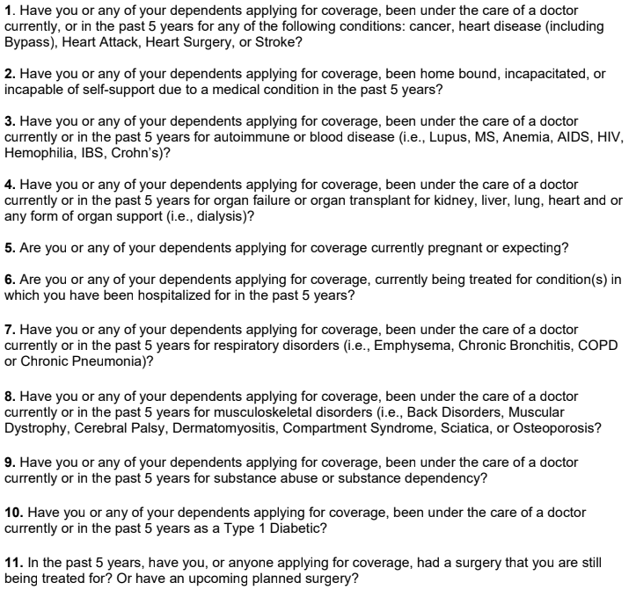
11
Underwriting Questions
No Height/Weight
Type 2 Diabetics allowed
All Pre-Ex covered once plan starts

Slide 7
PLAN OPTIONS
America’s Choice offers 13 plan types
METAL PLANS
ANNUAL MAX PLANS
HSA PLANS
500 TITANIUM
1,000 DIAMOND
1,500 PLATINUM
2,500 GOLD
3,500 SILVER
5,000 BRONZE
7,350 COPPER
ACHP 100
ACHP 250
ACHP 500
2,500 HSA
3,500 HSA
5,000 HSA

Slide 8
AMERICA’S CHOICE
ANNUAL MAX PLANS

Slide 9
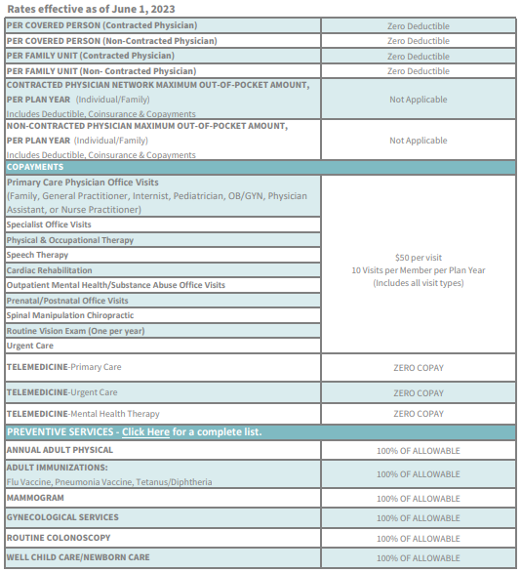
HIGHLIGHTS
ANNUAL MAX 500
NO DEDUCTIBLE - All Copays!
$500,000 Annual Max - $2,500,000 Lifetime Max
NO PRE-EXISTING EXCLUSIONS - No Waiting Periods
ALL ACA Preventive services covered
$0 Copay for Telemedicine - Primary, Urgent, Mental
Cancer covered - $150 copay/treatment - $25k Max
APS Rx - Designed for Acute Care
Very Affordable Rates!

Slide 10
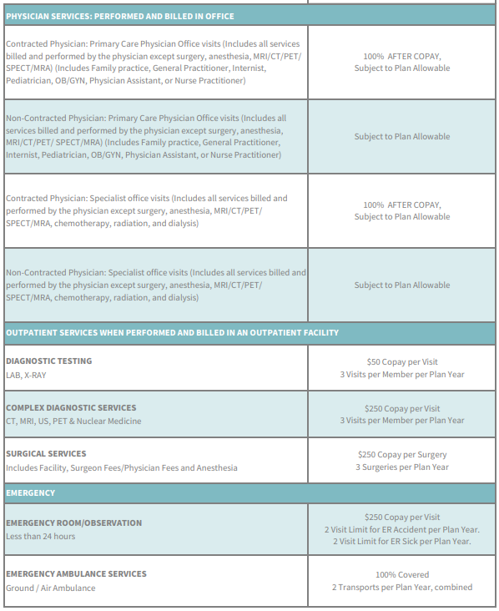
HIGHLIGHTS
ANNUAL MAX 500
NO DEDUCTIBLE - All Copays!
$500,000 Annual Max - $2,500,000 Lifetime Max
NO PRE-EXISTING EXCLUSIONS - No Waiting Periods
ALL ACA Preventive services covered
$0 Copay for Telemedicine - Primary, Urgent, Mental
Cancer covered - $150 copay/treatment - $25k Max
APS Rx - Designed for Acute Care
Very Affordable Rates!

Slide 11
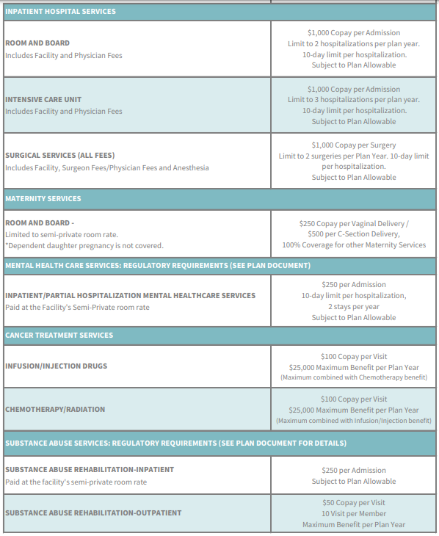
HIGHLIGHTS
ANNUAL MAX 500
NO DEDUCTIBLE - All Copays!
$500,000 Annual Max - $2,500,000 Lifetime Max
NO PRE-EXISTING EXCLUSIONS - No Waiting Periods
ALL ACA Preventive services covered
$0 Copay for Telemedicine - Primary, Urgent, Mental
Cancer covered - $150 copay/treatment - $25k Max
APS Rx - Designed for Acute Care
Very Affordable Rates!

Slide 12
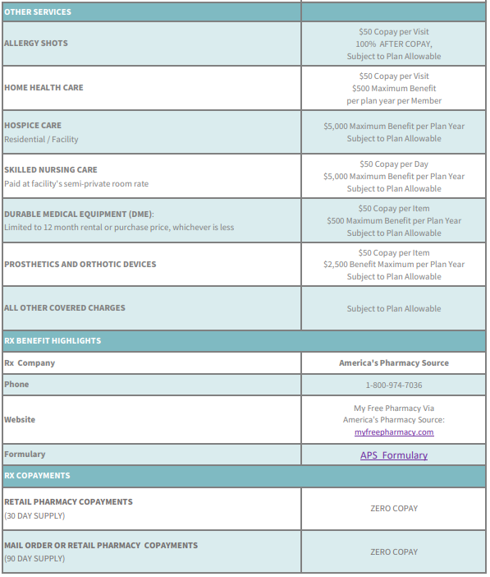
HIGHLIGHTS
ANNUAL MAX 500
NO DEDUCTIBLE - All Copays!
$500,000 Annual Max - $2,500,000 Lifetime Max
NO PRE-EXISTING EXCLUSIONS - No Waiting Periods
ALL ACA Preventive services covered
$0 Copay for Telemedicine - Primary, Urgent, Mental
Cancer covered - $150 copay/treatment - $25k Max
APS Rx - Designed for Acute Care
Very Affordable Rates!

Slide 13
AMERICA’S PHARMACY SOURCE HIGHLIGHTS
ANNUAL MAX PLANS 100-500 & COPPER 7350
Over 125 acute medications and over 480 maintenance medications
Home delivery service with tracking through USPS
30 and 90-day supply options
*Specialty medications are not covered

Slide 14
ANNUAL MAX
PLANS 100-500
PLAN PRICING
 | ACHP 100 | ACHP 250 | ACHP 500
Employee Only | $399.00 | $449.00 | $479.00
Employee / Spouse | $599.00 | $639.00 | $679.00
Employee / Child(ren) | $559.00 | $589.00 | $629.00
Employee / Family | $799.00 | $849.00 | $929.00

Slide 15
AMERICA’S CHOICE
METAL PLANS

Slide 16
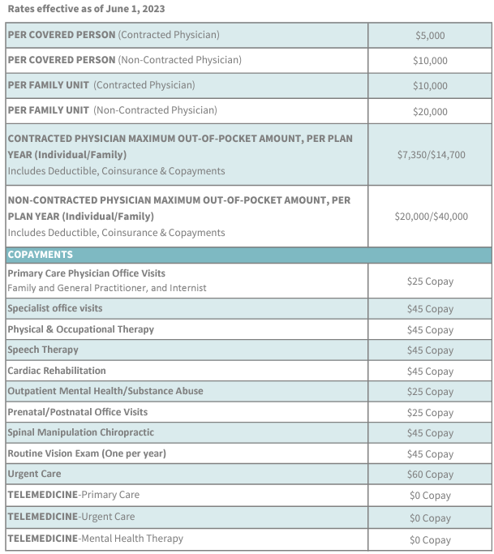
HIGHLIGHTS
$5000 BRONZE METAL PLAN
No Annual or Lifetime Limits!
Numerous Copays
ACA Compliant - no Subsidy
80/20 Co-insurance - MOOP $7,350 (2x Family)
NO PRE-EXISTING EXCLUSIONS - No Waiting Periods
ALL ACA Preventive services covered
$0 Copay for Telemedicine - Primary, Urgent, Mental
Medalist Rx - Comprehensive Rx Coverage
3 HSA Options available!

Slide 17
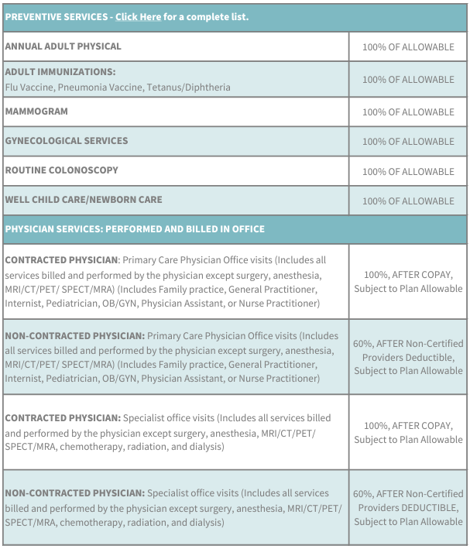
HIGHLIGHTS
$5000 BRONZE METAL PLAN
No Annual or Lifetime Limits!
Numerous Copays
ACA Compliant - no Subsidy
80/20 Co-insurance - MOOP $7,350 (2x Family)
NO PRE-EXISTING EXCLUSIONS - No Waiting Periods
ALL ACA Preventive services covered
$0 Copay for Telemedicine - Primary, Urgent, Mental
Medalist Rx - Comprehensive Rx Coverage
3 HSA Options available!

Slide 18
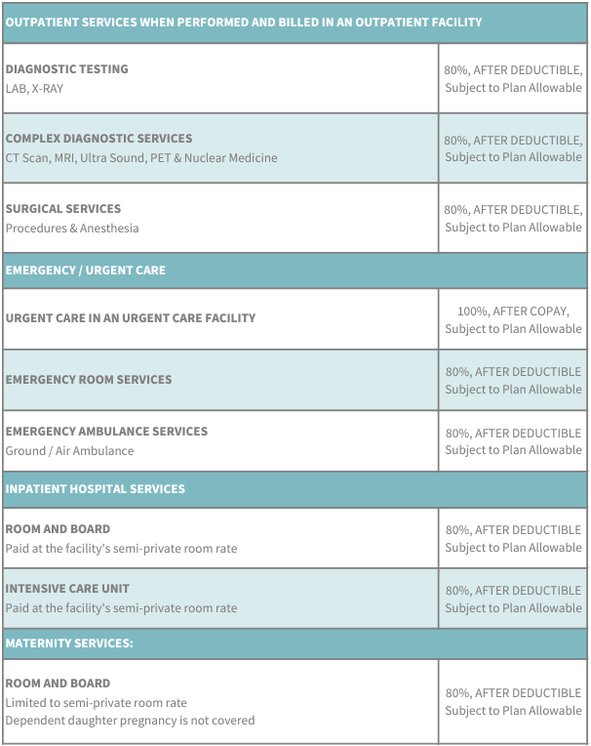
HIGHLIGHTS
$5000 BRONZE METAL PLAN
No Annual or Lifetime Limits!
Numerous Copays
ACA Compliant - no Subsidy
80/20 Co-insurance - MOOP $7,350 (2x Family)
NO PRE-EXISTING EXCLUSIONS - No Waiting Periods
ALL ACA Preventive services covered
$0 Copay for Telemedicine - Primary, Urgent, Mental
Medalist Rx - Comprehensive Rx Coverage
3 HSA Options available!

Slide 19
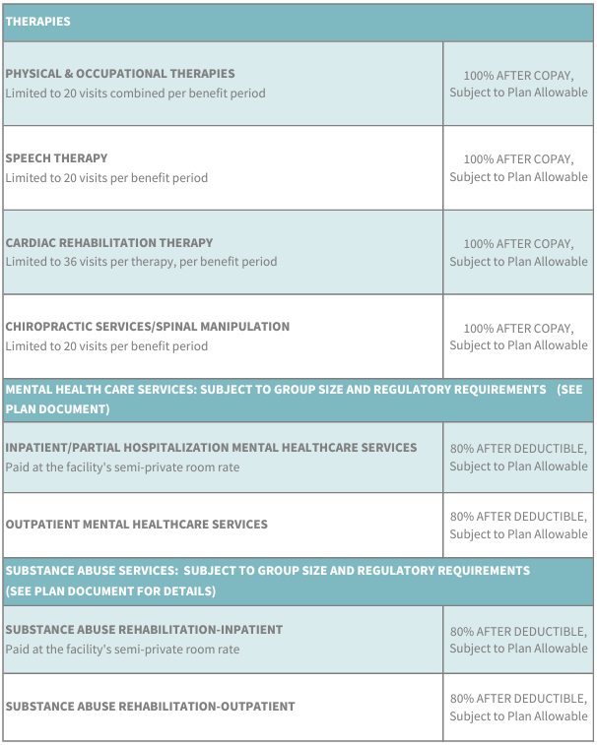
HIGHLIGHTS
$5000 BRONZE METAL PLAN
No Annual or Lifetime Limits!
Numerous Copays
ACA Compliant - no Subsidy
80/20 Co-insurance - MOOP $7,350 (2x Family)
NO PRE-EXISTING EXCLUSIONS - No Waiting Periods
ALL ACA Preventive services covered
$0 Copay for Telemedicine - Primary, Urgent, Mental
Medalist Rx - Comprehensive Rx Coverage
3 HSA Options available!

Slide 20
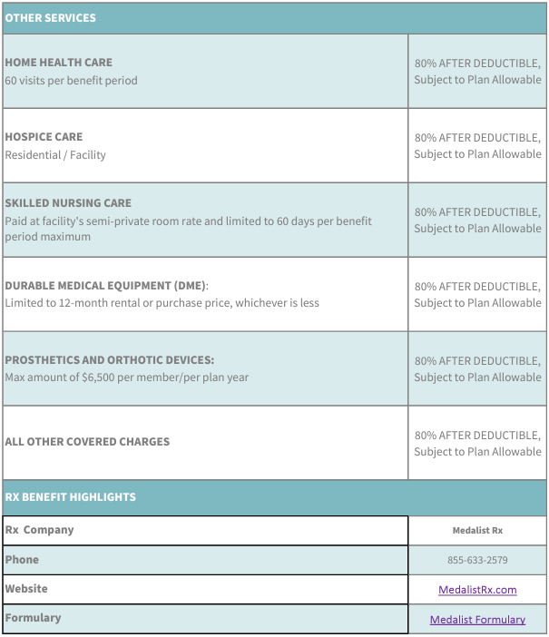
HIGHLIGHTS
$5000 BRONZE METAL PLAN
No Annual or Lifetime Limits!
Numerous Copays
ACA Compliant - no Subsidy
80/20 Co-insurance - MOOP $7,350 (2x Family)
NO PRE-EXISTING EXCLUSIONS - No Waiting Periods
ALL ACA Preventive services covered
$0 Copay for Telemedicine - Primary, Urgent, Mental
Medalist Rx - Comprehensive Rx Coverage
3 HSA Options available!

Slide 21
MEDALIST RX - HIGHLIGHTS
METAL PLANS 500-5000 & HSA
Retail Pharmacy Options (30-Day Supply)
Generic - $10 Copayment
Brand Name - $45 Copayment
Non-preferred Brand - $100 Copayment
Mail Order/Retail Pharmacy Options (90-Day Supply)
Generic - $30 Copayment
Brand Name - $90 Copayment
Non-preferred Brand - $150 Copayment
*Specialty medications are not covered

Slide 22
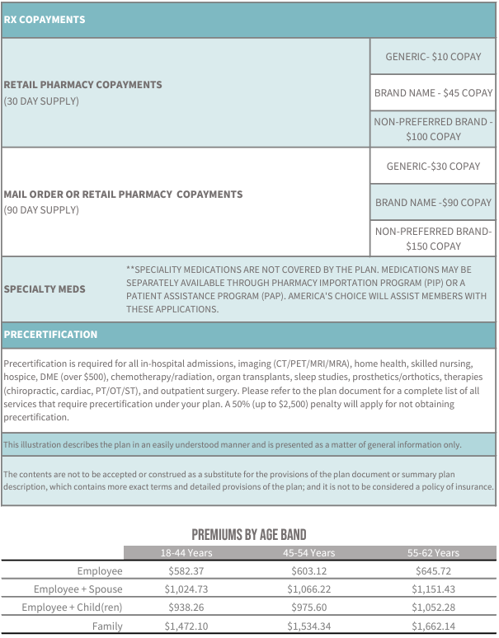
HIGHLIGHTS
$5000 BRONZE METAL PLAN
No Annual or Lifetime Limits!
Numerous Copays
ACA Compliant - no Subsidy
80/20 Co-insurance - MOOP $7,350 (2x Family)
NO PRE-EXISTING EXCLUSIONS - No Waiting Periods
ALL ACA Preventive services covered
$0 Copay for Telemedicine - Primary, Urgent, Mental
Medalist Rx - Comprehensive Rx Coverage
3 HSA Options available!

Slide 23
PHCS PRACTITIONER & ANCILLARY NETWORK
Check for your doctors - Can always nominate if not in-network
Hospitals and Facilities do not show up under network search
Scheduled Procedures - require a Precertification (866.815.6001)
Name of procedure and provider - Detego will do the rest
May search a driveable radius and make offer to client
Emergency - No Pre-Cert needed - go anywhere and get treatment
Out of Network Doctors - Detego will pay In-Network rate
Out of Network Hospitals/Surgery - RBP (up to 4x Medicare rate)

Slide 24
IMPORTANT DATES/CUTOFFS
1st - Monthly effective dates
23rd - Cutoff for upcoming 1st of month effective date
20th - All future monthly premium drafts
Must submit the application prior to primary turning 63
7-10 Business Days to receive physical insurance cards
Benefit Year is Calendar
Rate year resets on 06/01 - average 2% increase on Metal - 0% increase on Annual Max

Slide 25
IMPORTANT CONTACTS
MEMBER SUPPORT
(866)815-6001
Mon-Fri 8-6 ET
memberservices@detegohealth.com
AGENT SUPPORT
(920)631-1413
support@effectiveins.com

Slide 26
QUOTING & ENROLLING

Slide 27
THANK YOU

Slide 28
METAL PLANS
500-7350
PLAN PRICING AGE BANDED 18-44
 | $500/$1,000 TITANIUM | $1,000/$2,000 DIAMOND | $1,500/$3,000 PLATINUM | $2,500/$5,000 GOLD | $3,500/$7,000SILVER | $5,000/$10,000 BRONZE | $7,350/$14,700 COPPER
Employee Only | $849.46 | $793.51 | $735.00 | $688.49 | $621.67 | $582.37 | $495.77
Employee / Spouse | $1,558.90 | $1,446.99 | $1,330.00 | $1,236.96 | $1,103.32 | $1,024.73 | $851.54
Employee / Child(ren) | $1,419.02 | $1,318.30 | $1,213.00 | $1,129.26 | $1,008.99 | $938.26 | $782.39
Employee / Family | $2,273.37 | $2,105.50 | $1,930.00 | $1,790.44 | $1,589.99 | $1,472.10 | $1,212.32

Slide 29
METAL PLANS
500-7350
PLAN PRICING AGE BANDED 45-54
 | $500/$1,000 TITANIUM | $1,000/$2,000 DIAMOND | $1,500/$3,000 PLATINUM | $2,500/$5,000 GOLD | $3,500/$7,000SILVER | $5,000/$10,000 BRONZE | $7,350/$14,700 COPPER
Employee Only | $883.02 | $824.38 | $763.07 | $714.32 | $644.30 | $603.12 | $512.37
Employee / Spouse | $1,626.03 | $1,508.75 | $1,386.13 | $1,288.63 | $1,148.59 | $1,066.22 | $884.72
Employee / Child(ren) | $1,479.43 | $1,378.88 | $1,263.52 | $1,175.77 | $1,049.73 | $975.60 | $812.25
Employee / Family | $2,374.05 | $2,198.12 | $2,014.21 | $1,876.96 | $1,657.89 | $1,534.34 | $1,262.09

Slide 30
METAL PLANS
500-7350
PLAN PRICING AGE BANDED 55-62
 | $500/$1,000 TITANIUM | $1,000/$2,000 DIAMOND | $1,500/$3,000 PLATINUM | $2,500/$5,000 GOLD | $3,500/$7,000SILVER | $5,000/$10,000 BRONZE | $7,350/$14,700 COPPER
Employee Only | $984.23 | $917.49 | $847.71 | $792.23 | $690.77 | $645.72 | $546.44
Employee / Spouse | $1,828.43 | $1,694.95 | $1,555.41 | $1,444.45 | $1,241.54 | $1,151.43 | $952.86
Employee / Child(ren) | $1,661.58 | $1,541.46 | $1,415.87 | $1,316.00 | $1,133.38 | $1,052.28 | $873.58
Employee / Family | $2,677.64 | $2,477.43 | $2,268.12 | $2,101.68 | $1,797.31 | $1,662.14 | $1,364.30

Slide 31
HSA PLANS
2500, 3500, 5000
PLAN PRICING AGE BANDED 18-44
 | 2500 HSA | 3500 HSA | 5000 HSA
Employee Only | $645.40 | $560.12 | $543.71
Employee / Spouse | $1150.81 | $980.23 | $947.42
Employee / Child(ren) | $1051.72 | $898.21 | $868.68
Employee / Family | $1661.21 | $1405.35 | $1356.13

Slide 32
HSA PLANS
2500, 3500, 5000
PLAN PRICING AGE BANDED 45-54
 | 2500 HSA | 3500 HSA | 5000 HSA
Employee Only | $669.18 | $579.80 | $562.61
Employee / Spouse | $1198.34 | $1019.59 | $985.20
Employee / Child(ren) | $1094.51 | $933.63 | $902.68
Employee / Family | $1732.52 | $1464.38 | $1412.81

Slide 33
HSA PLANS
2500, 3500, 5000
PLAN PRICING AGE BANDED 55-62
 | 2500 HSA | 3500 HSA | 5000 HSA
Employee Only | $740.86 | $620.21 | $601.40
Employee / Spouse | $1341.70 | $1100.40 | $1062.79
Employee / Child(ren) | $1223.52 | $1006.37 | $972.51
Employee / Family | $1947.54 | $1585.61 | $1529.19

